Slide 1
2017

Slide 2
Advertising – Television – $15,000 or Less
1st Place
“Don’t Be Camera Shy”
SoutheastHEALTH
Cape Girardeau

Slide 3
SoutheastHEALTH
Cape Girardeau

Slide 4
Advertising – Television – $15,000 or Less
2nd Place
“Make a Date”
Liberty Hospital

Slide 5
Advertising – Television – $15,000 or Less
3rd Place
“After the Lights”
Liberty Hospital

Slide 6
2017

Slide 7
Advertising – Television – Greater Than $15,000
1st Place
“St. Joseph & St. Mary’s Medical Centers Emergency Department
Television Advertisement”
St. Joseph Medical Center
Kansas City

Slide 8
St. Joseph Medical Center
Kansas City

Slide 9
Advertising – Television – Greater Than $15,000
2nd Place
“Guardians of Childhood”
St. Louis Children’s Hospital

Slide 10
Advertising – Television – Greater Than $15,000
3rd Place
“YES Finds A Way”
MU Health Care
Columbia

Slide 11
2017

Slide 12
Advertising – Radio – $1,000 or Less
1st Place
“Mizzou Urgent Care”
MU Health Care
Columbia

Slide 13
MU Health Care
Columbia

Slide 14
2017

Slide 15
Advertising – Radio – Greater Than $1,000
1st Place
“Nurse Recruitment”
MU Health Care
Columbia

Slide 16
MU Health Care
Columbia

Slide 17
Advertising – Radio – Greater Than $1,000
2nd Place
“Little Things Radio”
Children’s Mercy Kansas City
and Behemoth

Slide 18
Advertising – Radio – Greater Than $1,000
3rd Place
“Guardians of Childhood”
St. Louis Children’s Hospital

Slide 19
2017

Slide 20
Advertising – Print – $1,500 or Less
1st Place
“Bladeless Laser Cataract Surgery”
MU Health Care
Columbia

Slide 21
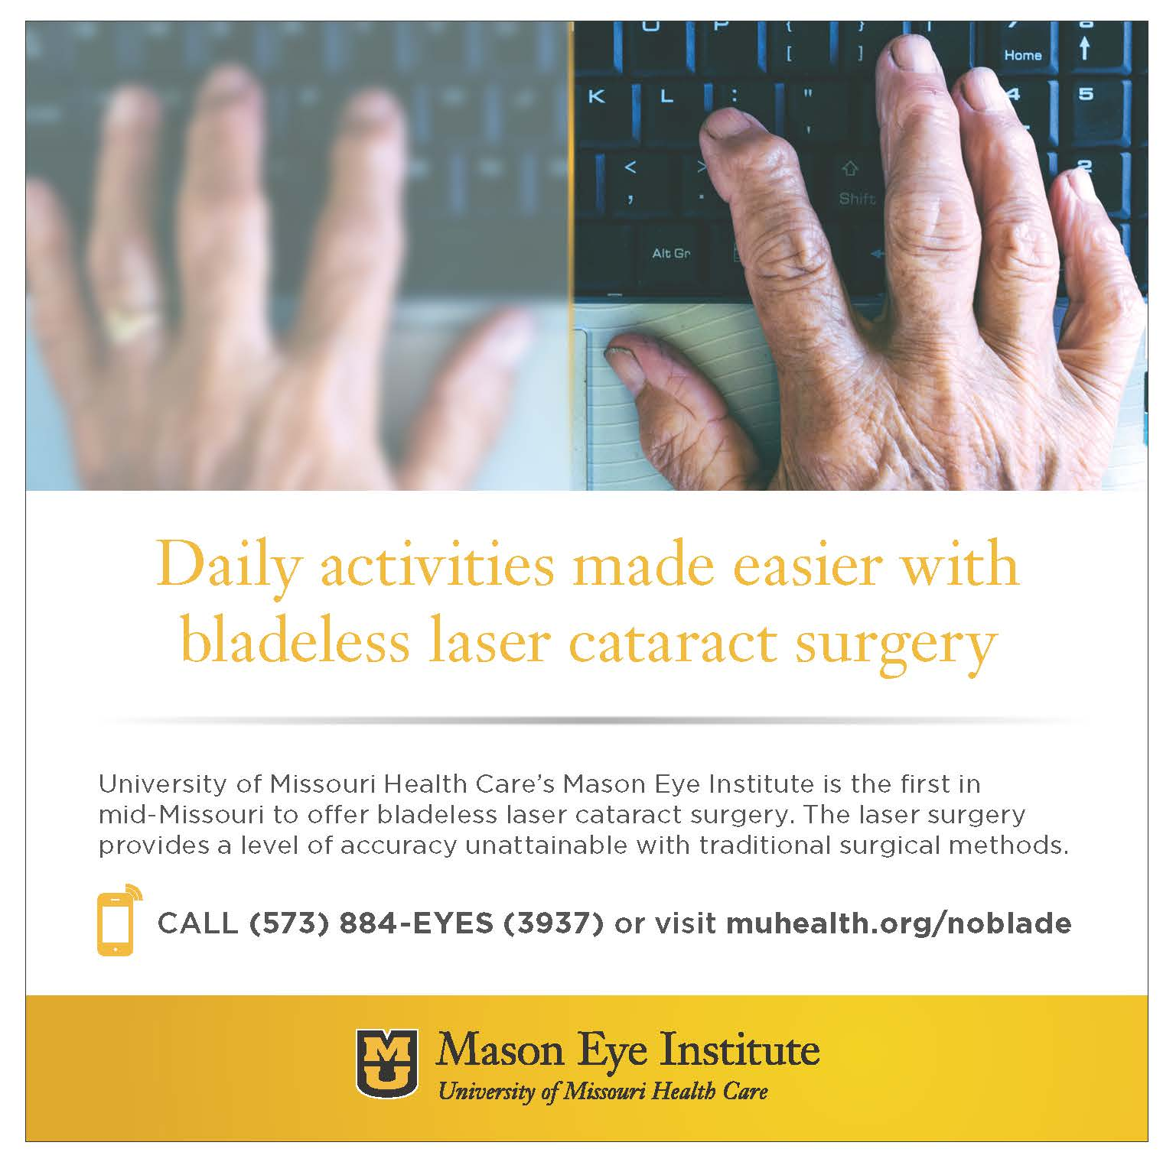
MU Health Care
Columbia

Slide 22
Advertising – Print – $1,500 or Less
2nd Place
“Come see our Moms”
Fitzgibbon Hospital
Marshall

Slide 23
Advertising – Print – $1,500 or Less
3rd Place
“Holiday Mishap?”
Fitzgibbon Hospital
Marshall

Slide 24
2017

Slide 25
Advertising – Print – Greater Than $1,500
1st Place
“Mizzou BioJointSM Center”
MU Health Care
Columbia

Slide 26
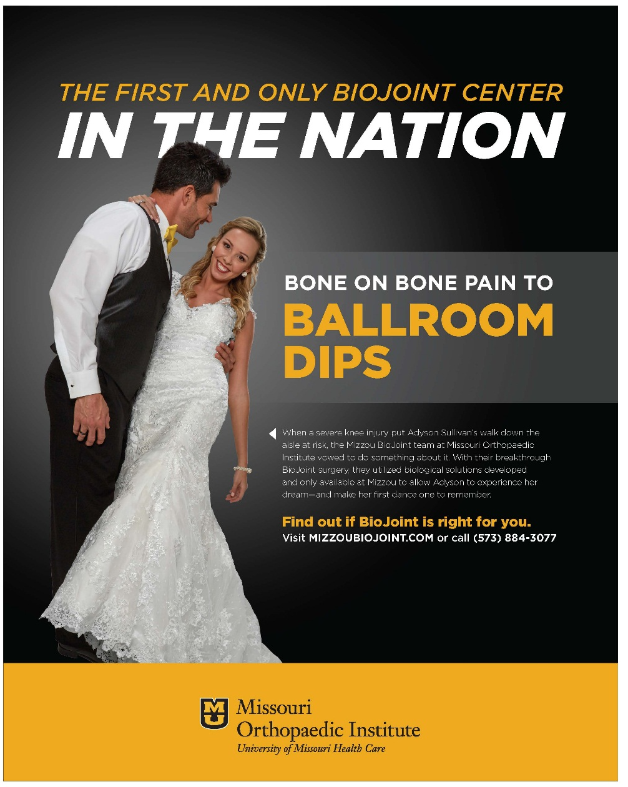
MU Health Care
Columbia

Slide 27
Advertising – Print – Greater Than $1,500
2nd Place
“Guardians of Childhood”
St. Louis Children’s Hospital

Slide 28
Advertising – Print – Greater Than $1,500
3rd Place
“Urgent Care” and “After the Lights”
Liberty Hospital

Slide 29
2017

Slide 30
Advertising – Outdoor
1st Place
“Many More Celebrations”
Fitzgibbon Hospital
Marshall

Slide 31
Fitzgibbon Hospital
Marshall

Slide 32
Advertising – Outdoor
2nd Place
“Liberty Hospital Half Marathon/5K”
Liberty Hospital

Slide 33
Advertising – Outdoor
3rd Place
“Mizzou BioJointSM Center”
MU Health Care
Columbia

Slide 34
2017

Slide 35
Advertising – Multimedia Campaign – $20,000 or Less
1st Place
“Foundation End of Year Appeal”
Saint Francis Healthcare System
Cape Girardeau

Slide 36
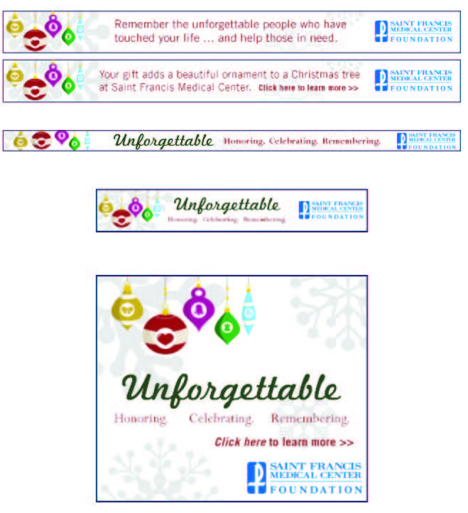
Saint Francis Healthcare System
Cape Girardeau

Slide 37
Advertising – Multimedia Campaign – $20,000 or Less
1st Place
“Little Things Campaign”
Children’s Mercy Kansas City
and Behemoth

Slide 38
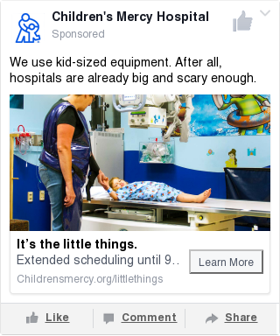
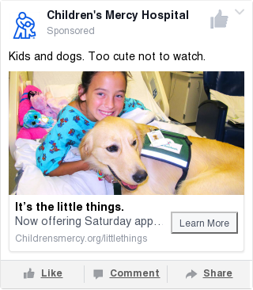
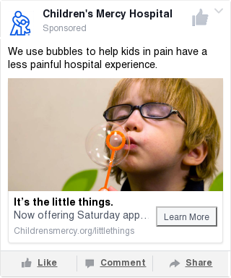
Children’s Mercy Kansas City
and Behemoth

Slide 39
Children’s Mercy Kansas City
and Behemoth

Slide 40
Advertising – Multimedia Campaign – $20,000 or Less
2nd Place
“Nurse Recruitment”
MU Health Care
Columbia

Slide 41
2017

Slide 42
Advertising – Multimedia Campaign – Greater Than $20,000
1st Place
“Guardians of Childhood”
St. Louis Children’s Hospital

Slide 43
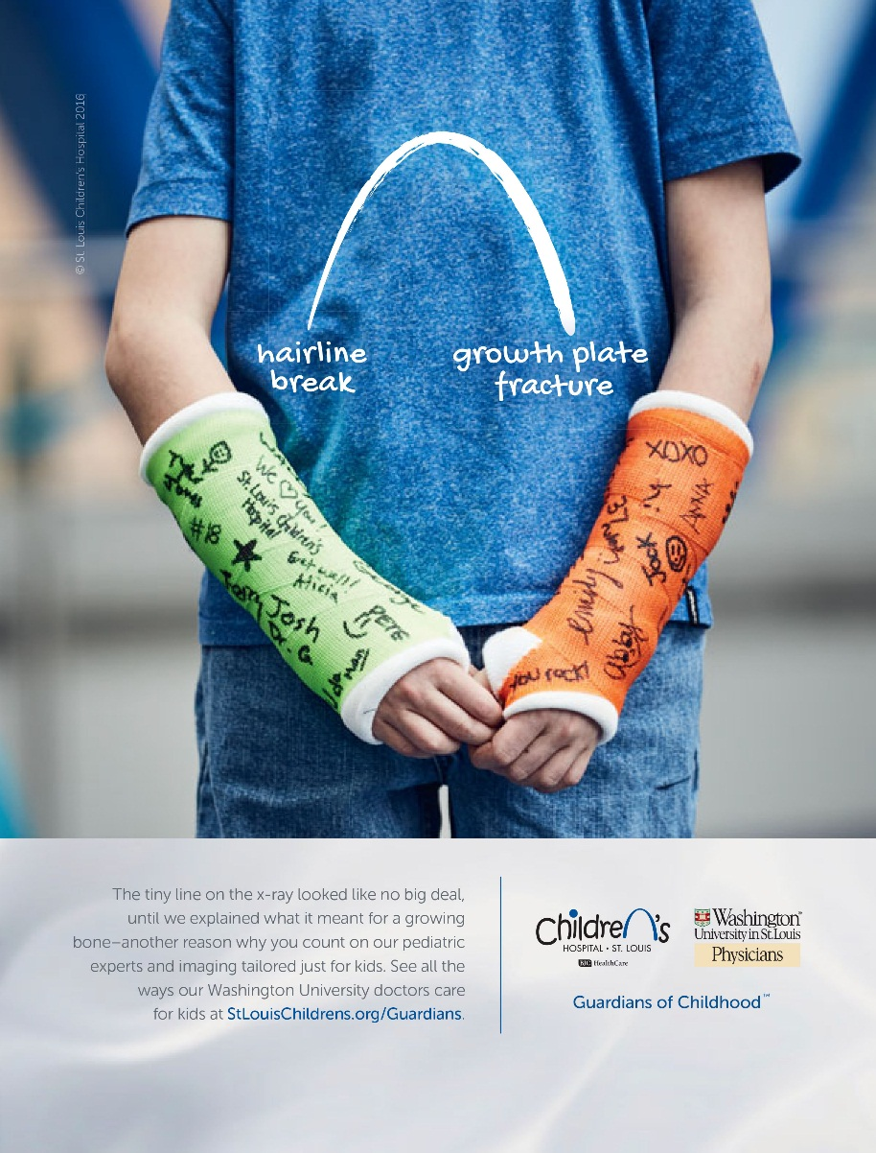
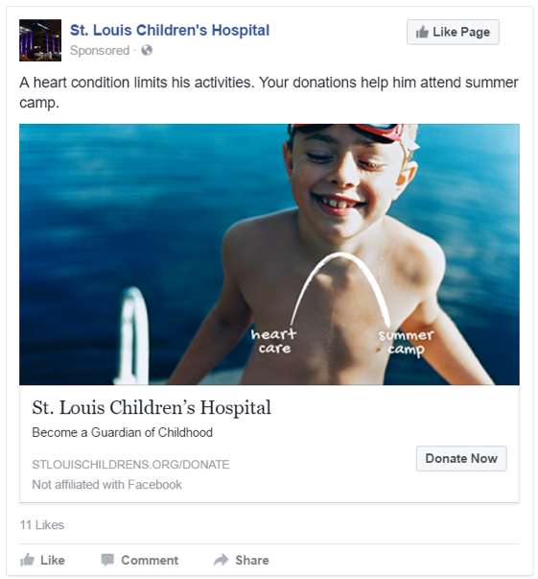
St. Louis Children’s Hospital

Slide 44
St. Louis Children’s Hospital

Slide 45
Advertising – Multimedia Campaign – Greater Than $20,000
2nd Place
“YES Finds A Way”
MU Health Care
Columbia

Slide 46
Advertising – Multimedia Campaign – Greater Than $20,000
3rd Place
“Mizzou BioJointSM Center”
MU Health Care
Columbia

Slide 47
2017

Slide 48
Best PR/Marketing Project for a Small/Rural Hospital
1st Place
“Ripley County Sales Tax
Initiative Campaign”
SoutheastHEALTH
Cape Girardeau

Slide 49
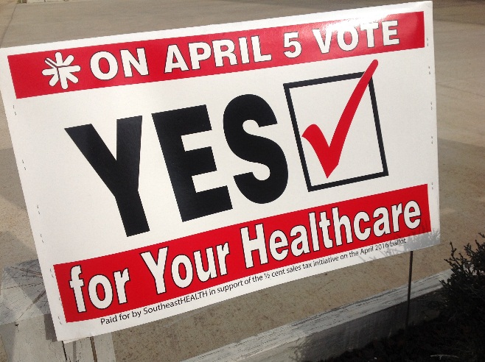
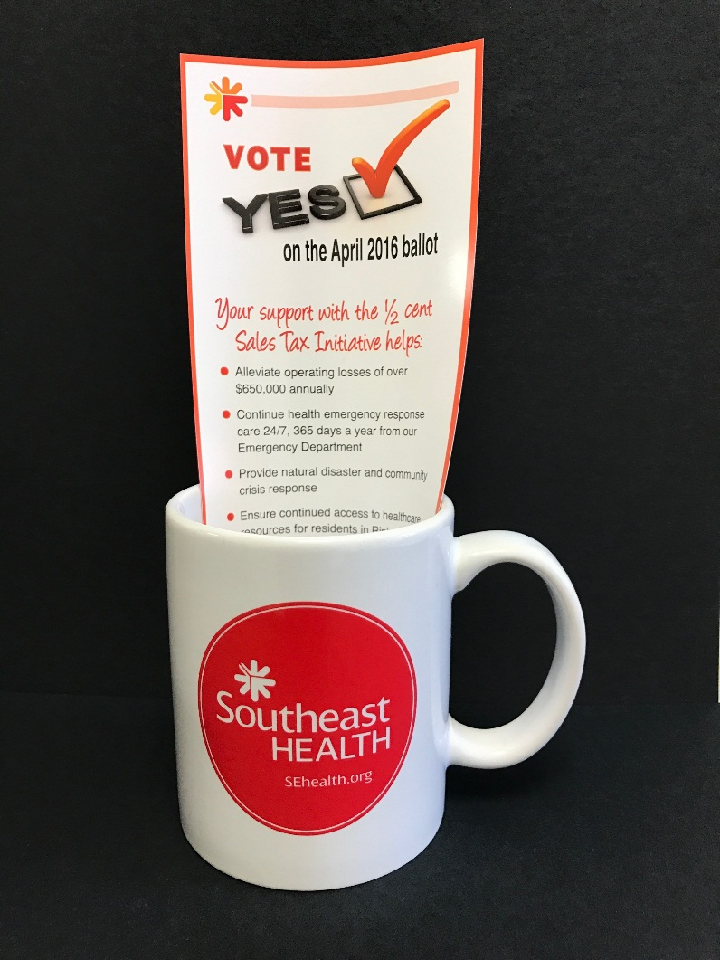
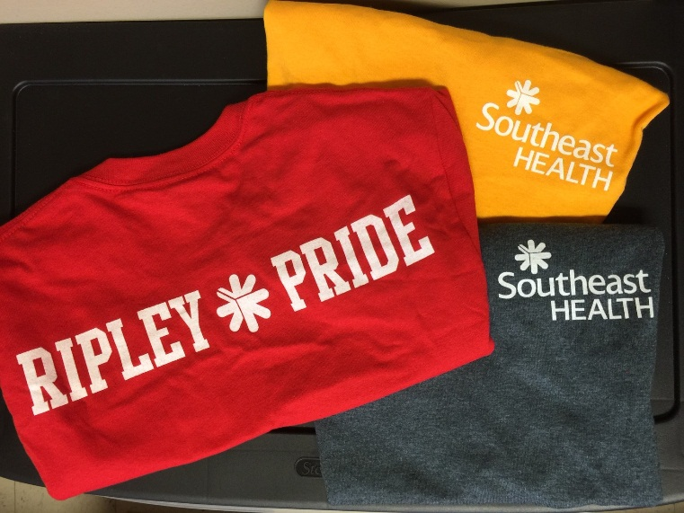
SoutheastHEALTH
Cape Girardeau

Slide 50
Best PR/Marketing Project for a Small/Rural Hospital
2nd Place
“Glow, Slow, Whoa”
Fitzgibbon Hospital
Marshall

Slide 51
Best PR/Marketing Project for a Small/Rural Hospital
2nd Place
“General Surgery at Cass Regional
Medical Center”
Cass Regional Medical Center
Harrisonville

Slide 52
2017

Slide 53
Cooperative Partnership
1st Place
“Pink Out”
Fitzgibbon Hospital
Marshall

Slide 54
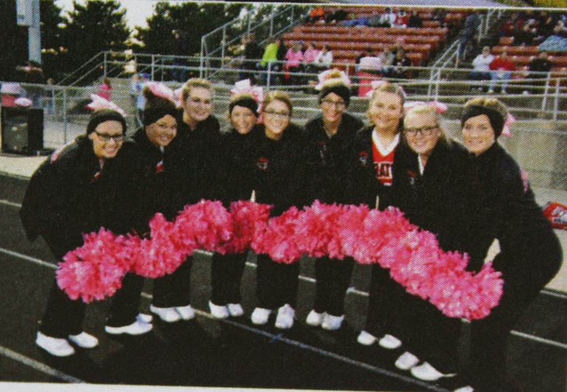
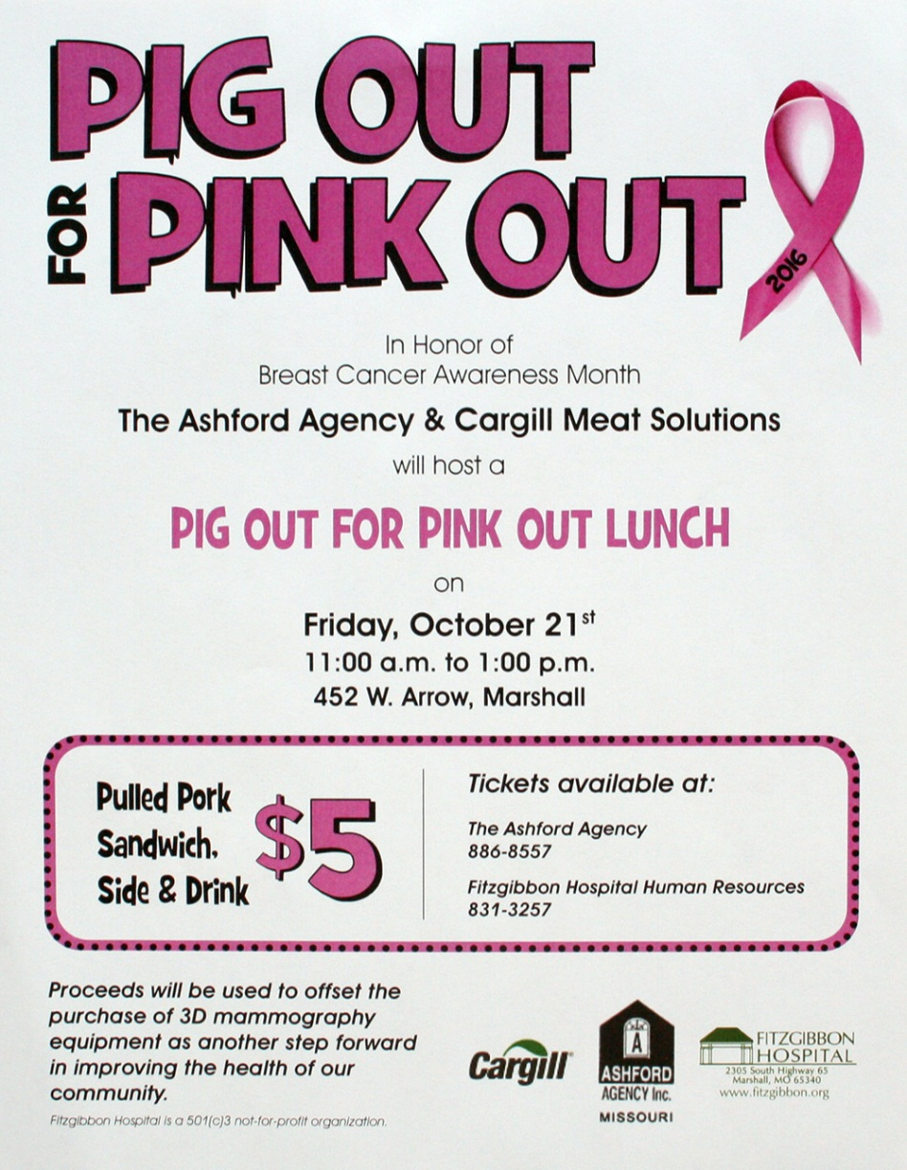
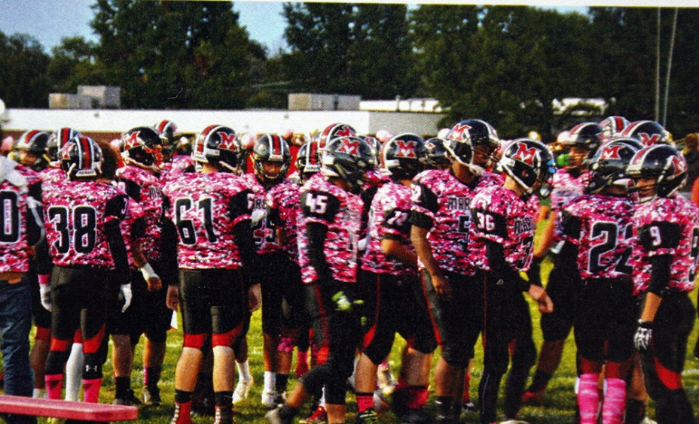
Fitzgibbon Hospital
Marshall

Slide 55
Cooperative Partnership
2nd Place
“Saint Luke’s Heart Walk Sponsorship”
Saint Luke’s Health System
Kansas City

Slide 56
Cooperative Partnership
3rd Place
“Wellness Corner”
North Kansas City Hospital

Slide 57
2017

Slide 58
Crisis Communications
1st Place
“Mumps”
MU Health Care
Columbia

Slide 59
MU Health Care
Columbia

Slide 60
MU Health Care
Columbia

Slide 61
Crisis Communications
2nd Place
“Distillery Chemical Spill Incident”
Mosaic Life Care
St. Joseph

Slide 62
Crisis Communications
3rd Place
“Zika”
MU Health Care
Columbia

Slide 63
2017

Slide 64
Direct Mail – Greater Than $2,500
1st Place
“New Mover”
MU Health Care
Columbia

Slide 65
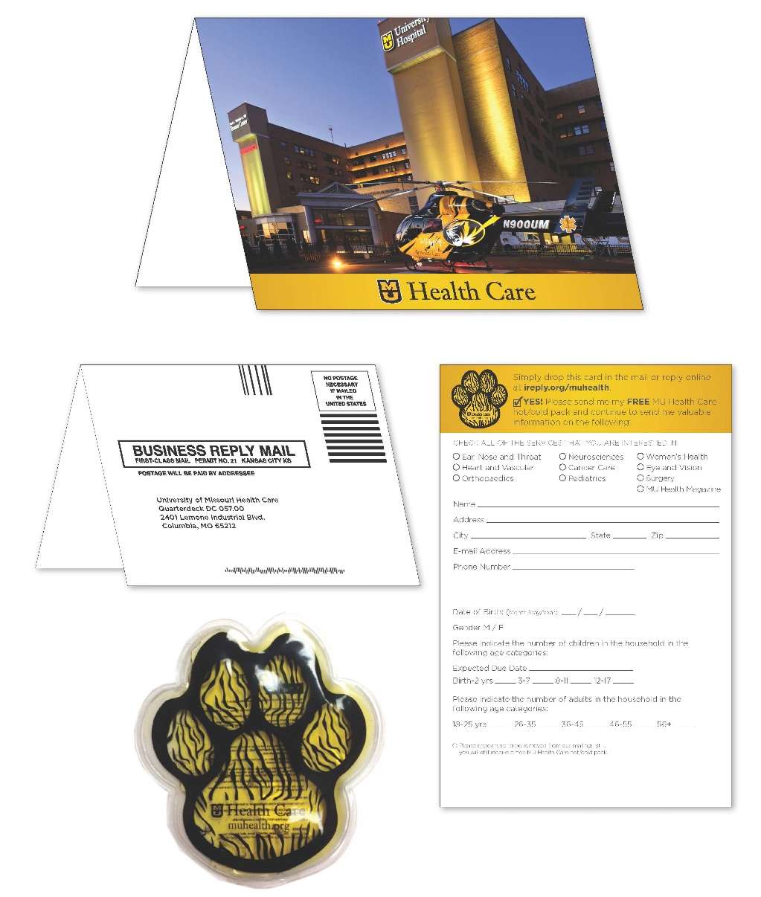
MU Health Care
Columbia

Slide 66
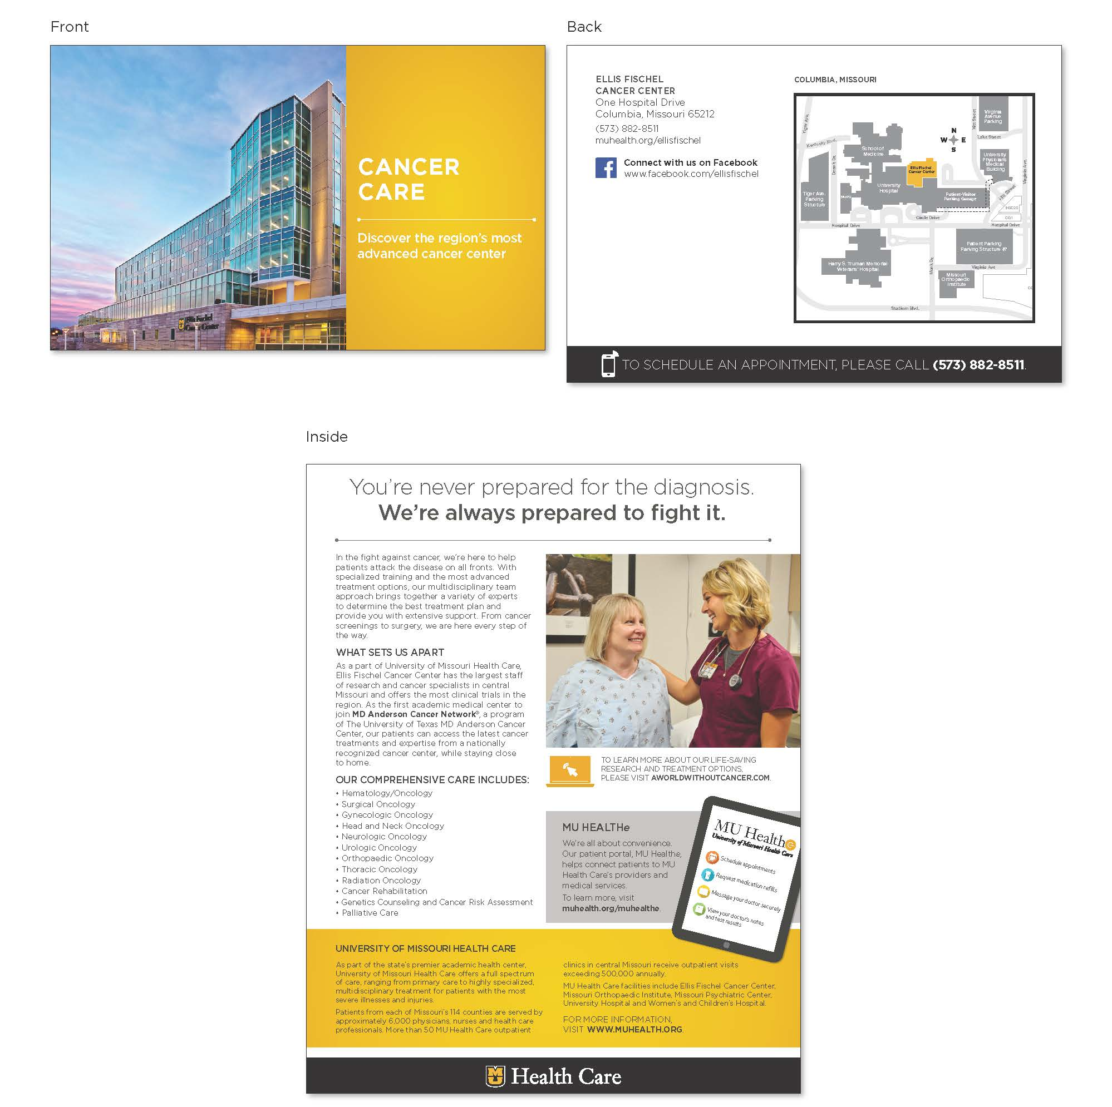
MU Health Care
Columbia

Slide 67
Direct Mail – Greater Than $2,500
2nd Place
“MU Children’s Hospital Pediatric Urgent Care”
MU Health Care
Columbia

Slide 68
Direct Mail – Greater Than $2,500
3rd Place
“Childhood Moments Direct Mail”
Almanac, Inc. on behalf of
St. Louis Children’s Hospital

Slide 69
2017

Slide 70
Employee Communications Projects – $2,500 or Less
1st Place
“Continuous Improvement Guides Barnes-Jewish West County Hospital”
Barnes-Jewish West County Hospital
St. Louis

Slide 71
Barnes-Jewish West County Hospital
St. Louis

Slide 72
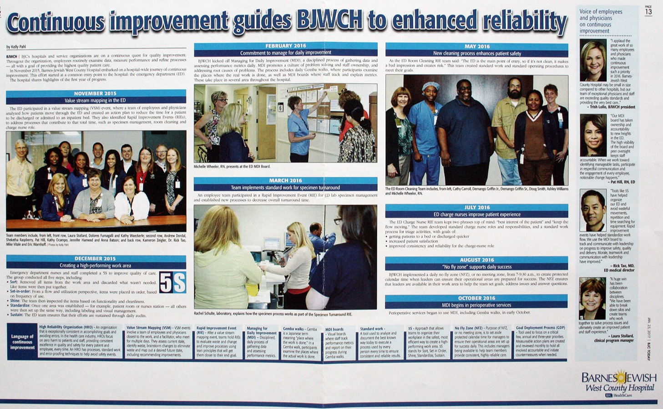
Barnes-Jewish West County Hospital
St. Louis

Slide 73
Employee Communications Projects – $2,500 or Less
2nd Place
“Language of Caring”
North Kansas City Hospital

Slide 74
Employee Communications Projects – $2,500 or Less
3rd Place
“Say YES to Giving”
MU Heath Care
Columbia

Slide 75
2017

Slide 76
Employee Communications Projects – Greater Than $2,500
1st Place
“SSM Health Retirement Campaign”
SMM Health
St. Louis

Slide 77
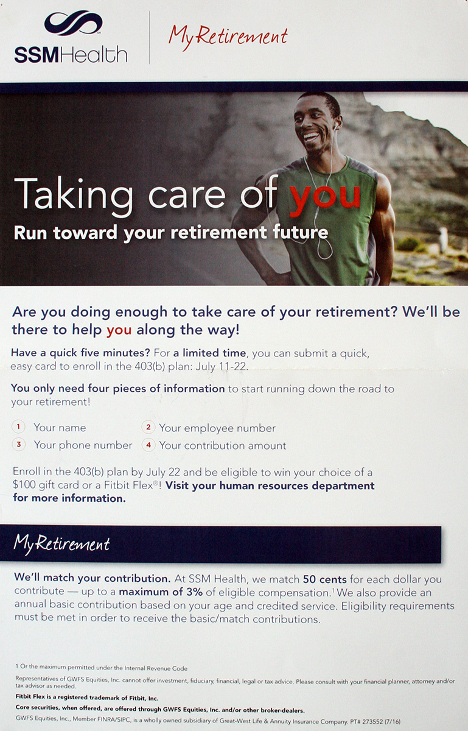
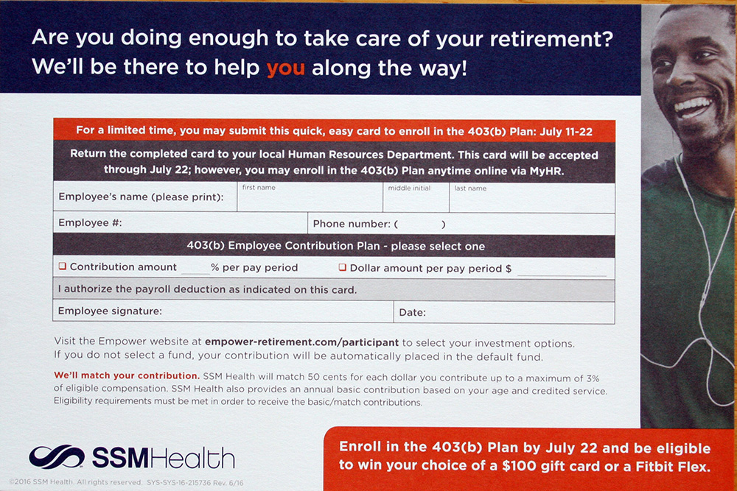
SMM Health
St. Louis

Slide 78
Employee Communications Projects – Greater Than $2,500
2nd Place
“Physician Epic Launch Campaign”
Saint Francis Healthcare System
Cape Girardeau

Slide 79
2017

Slide 80
Websites – Internet
1st Place
“Mizzou BioJointSM Center”
MU Health Care
Columbia

Slide 81
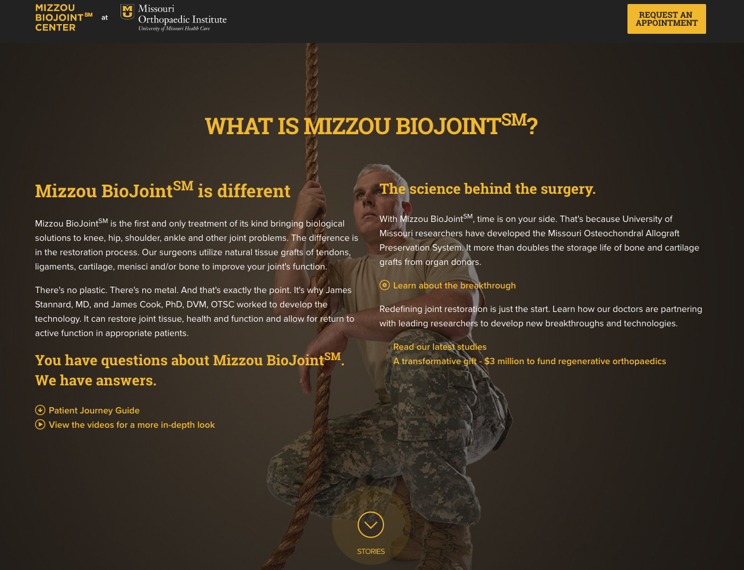
MU Health Care
Columbia

Slide 82
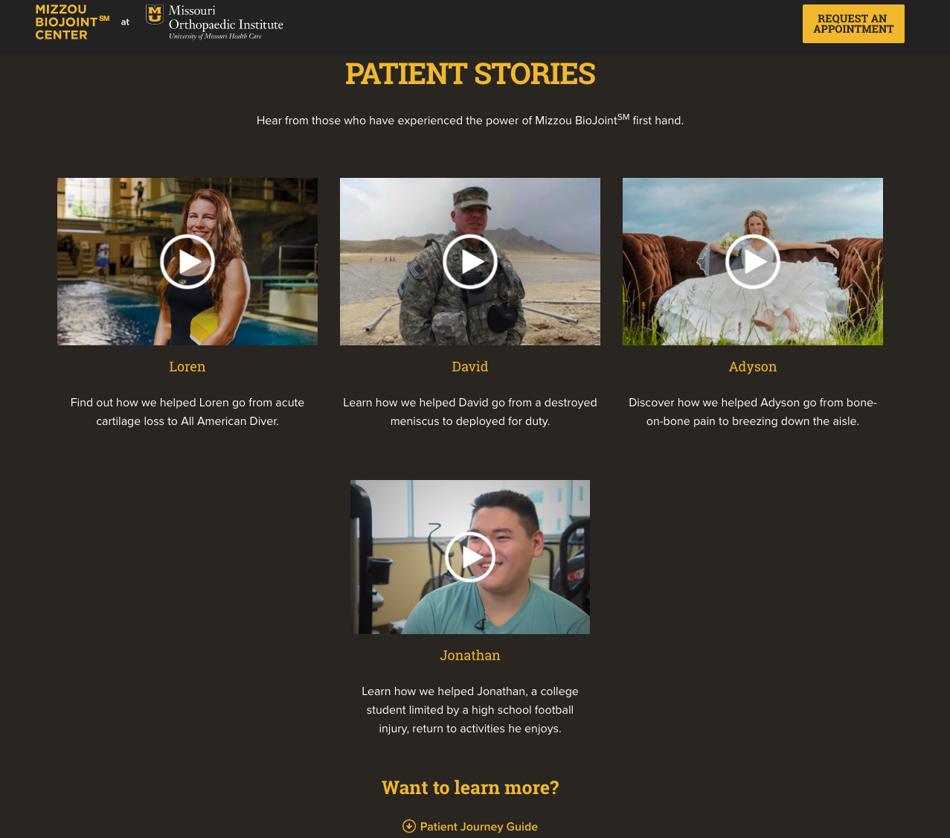
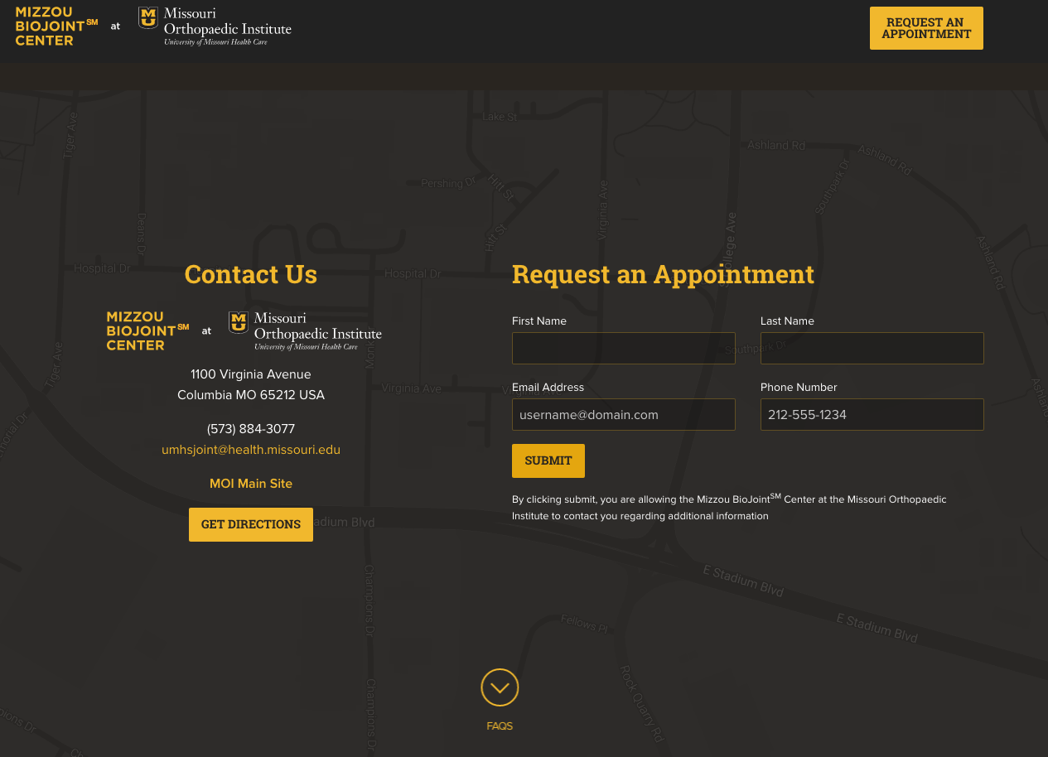
MU Health Care
Columbia

Slide 83
Websites – Internet
2nd Place
“Find A Doctor Redesign”
Children’s Mercy Kansas City

Slide 84
Websites – Internet
3rd Place
“Business Services”
Truman Medical Centers Inc.
Kansas City

Slide 85
2017

Slide 86
Social/Interactive Media
1st Place
“Living Proof”
MU Health Care
Columbia

Slide 87
MU Health Care
Columbia

Slide 88
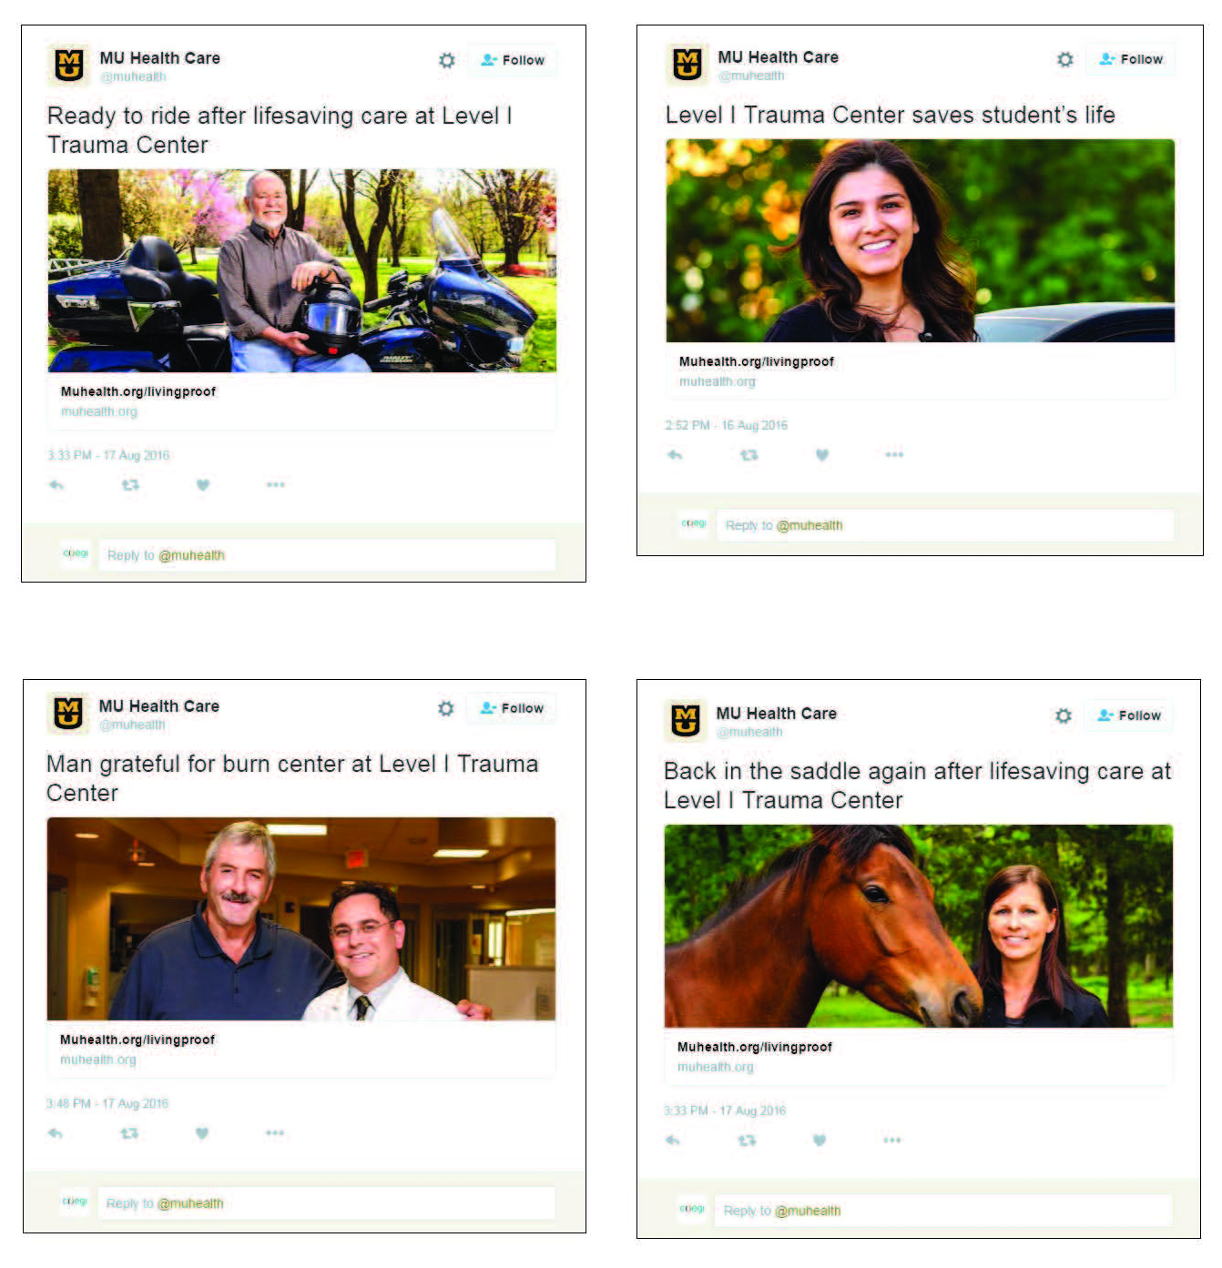
MU Health Care
Columbia

Slide 89
Social/Interactive Media
2nd Place
“Artful Bra Snapchat Filter”
MU Health Care
Columbia

Slide 90
Social/Interactive Media
3rd Place
“Women’s Health Announcement”
Hannibal Regional Healthcare System

Slide 91
2017

Slide 92
Physician Relations/Communications Projects
1st Place
“Transformational Pediatrics Podcasts”
Children’s Mercy Kansas City

Slide 93
Children’s Mercy Kansas City

Slide 94
Physician Relations/Communications Projects
2nd Place
“Transformational Pediatric
Direct Mail”
Children’s Mercy Kansas City

Slide 95
2017

Slide 96
Special Marketing or Public Relations Projects – $2,500 or Less
1st Place
“SSM Health Virtual Career Fair”
SSM Health
St. Louis

Slide 97
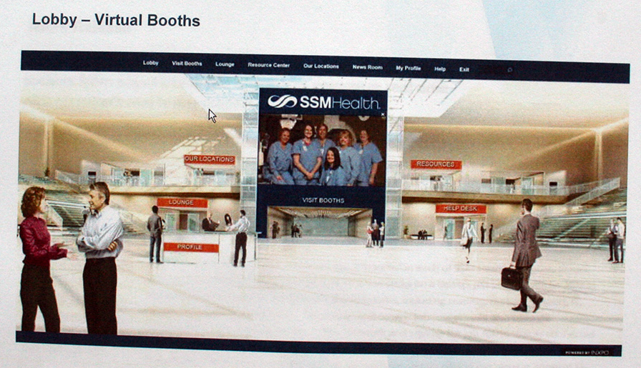
SSM Health
St. Louis

Slide 98
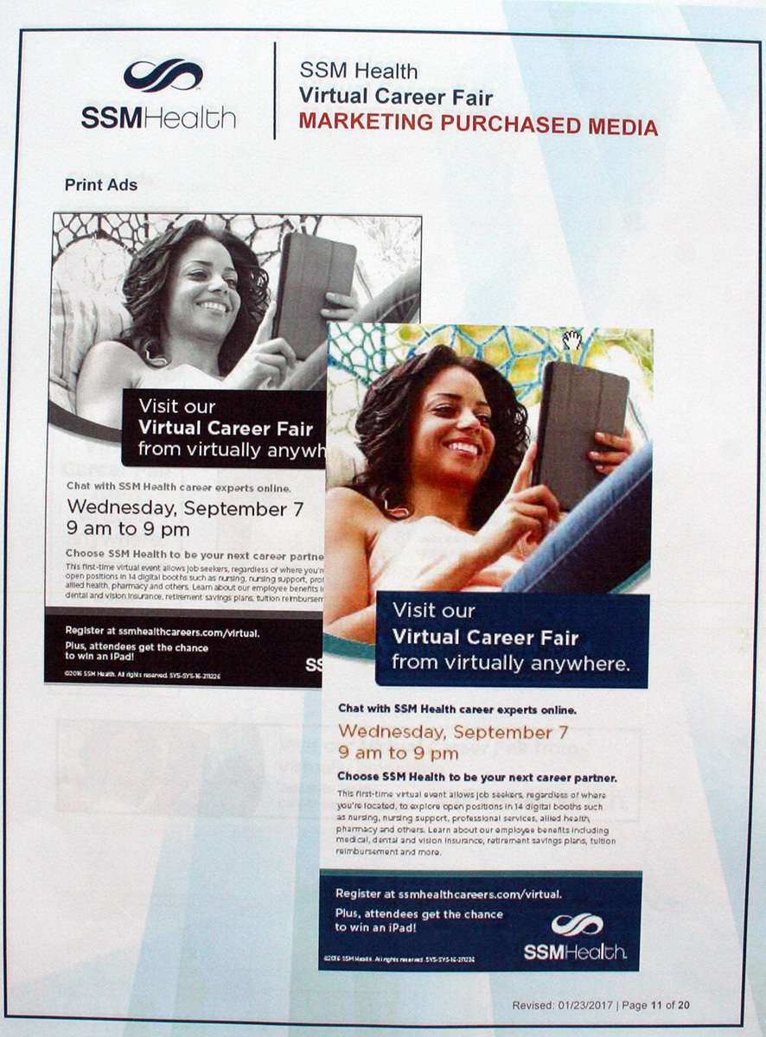
SSM Health
St. Louis

Slide 99
Special Marketing or Public Relations Projects – $2,500 or Less
2nd Place
“2016 OMC Superhero Fun Run”
Ozarks Medical Center
West Plains

Slide 100
Special Marketing or Public Relations Projects – $2,500 or Less
3rd Place
“Many More Celebrations”
Fitzgibbon Hospital
Marshall

Slide 101
2017

Slide 102
Special Marketing or Public Relations Projects – $2,500 to $10,000
1st Place
“Breast Cancer Awareness Month”
MU Health Care
Columbia

Slide 103
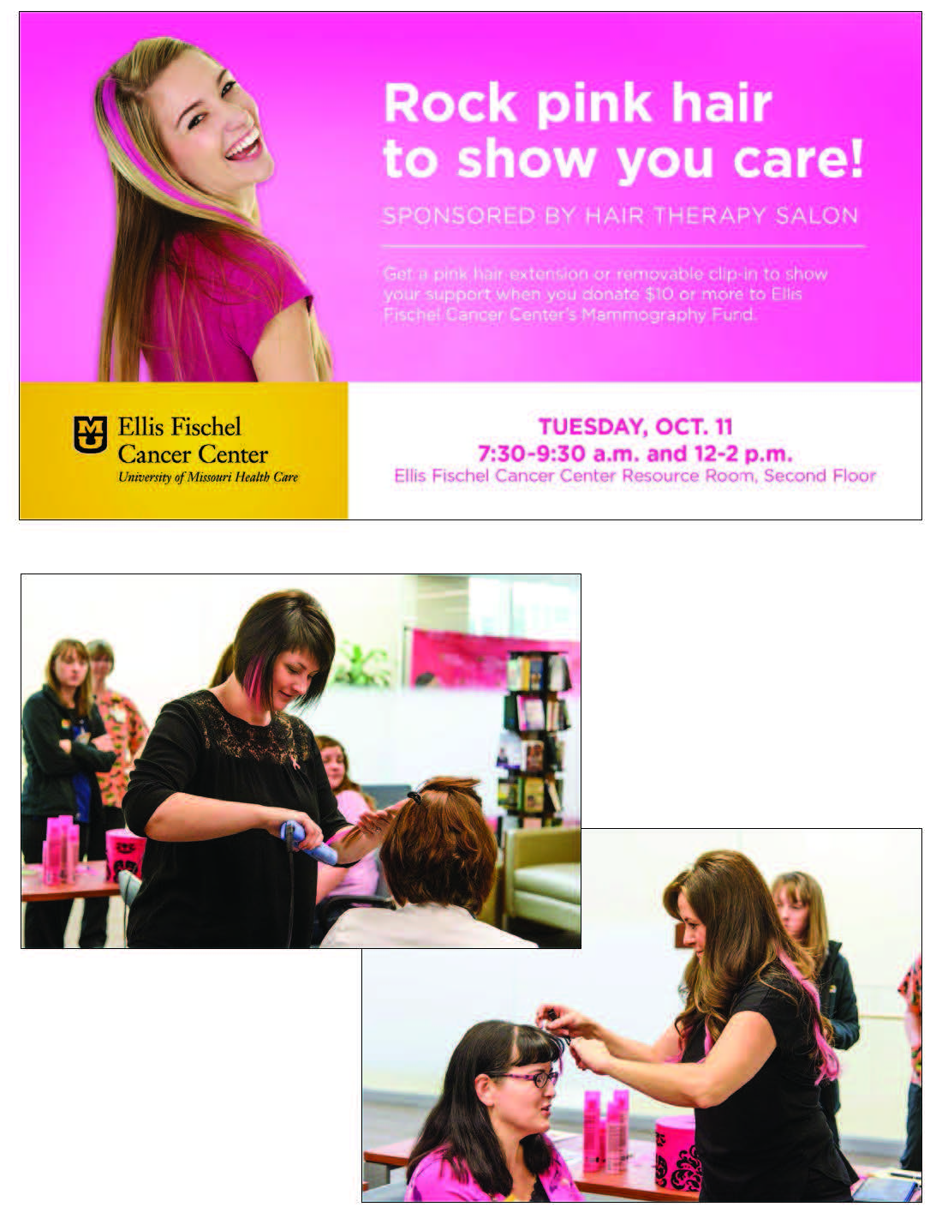
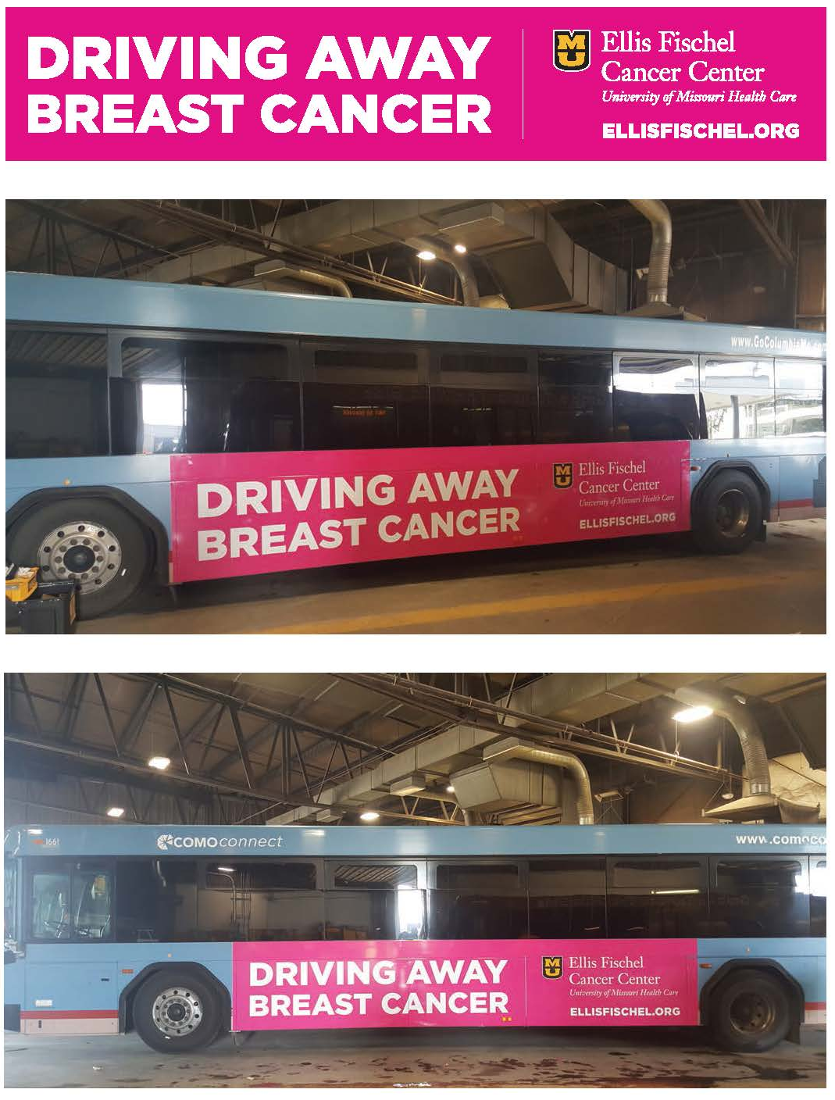
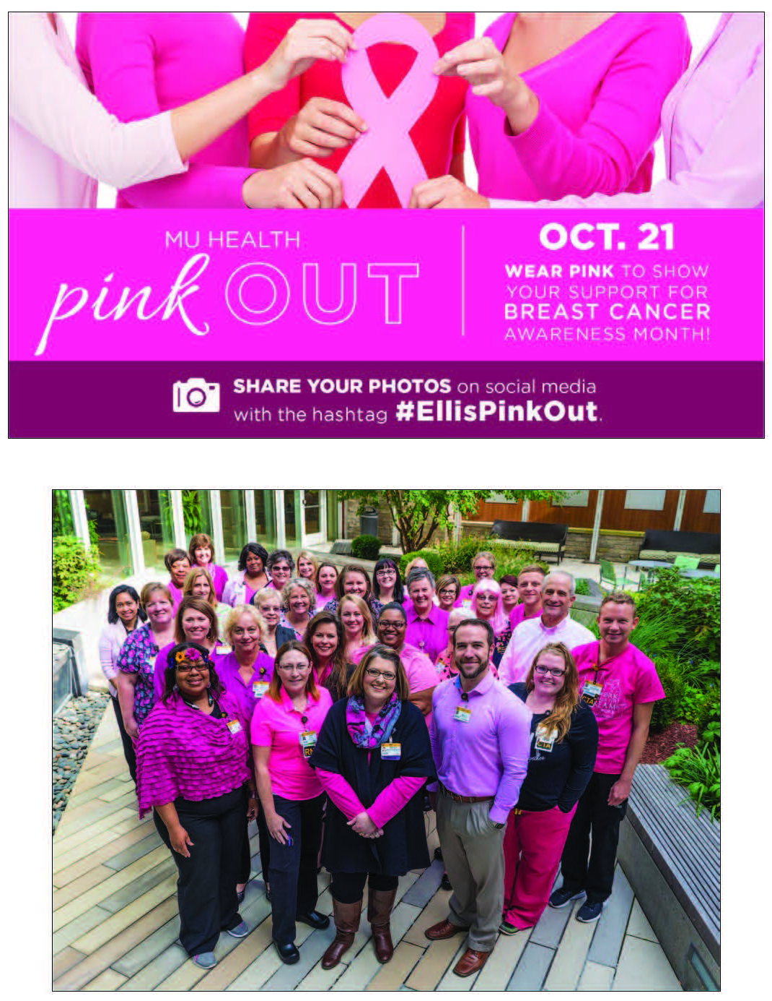
MU Health Care
Columbia

Slide 104
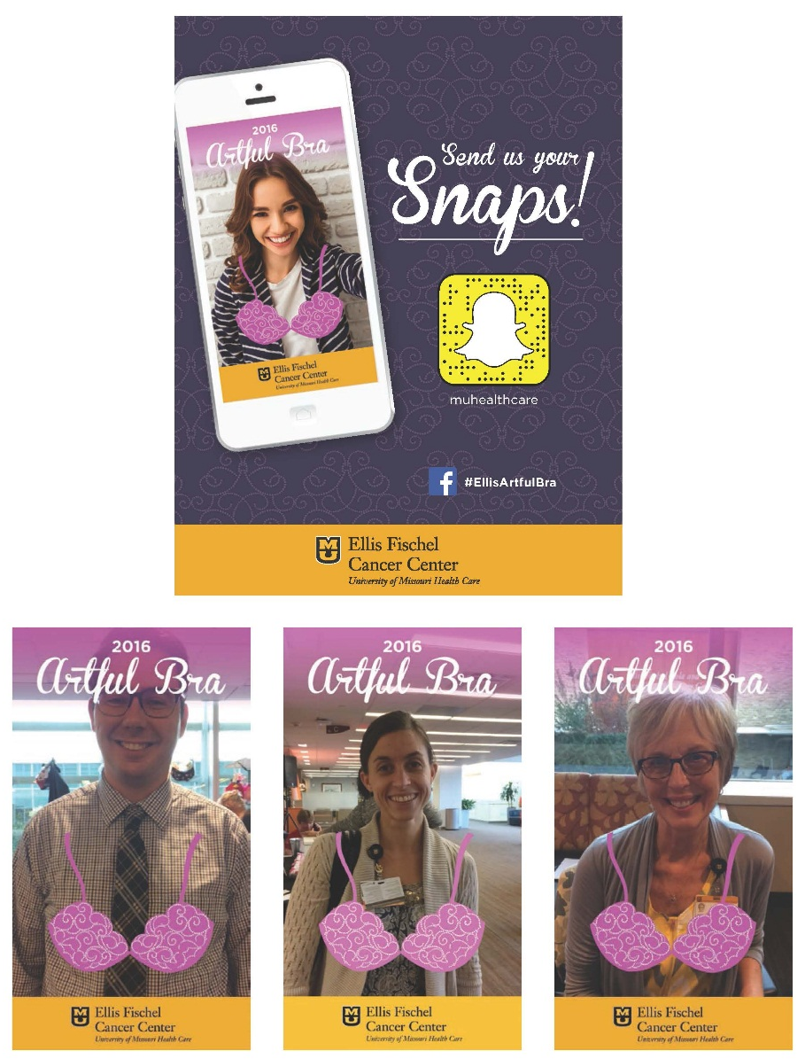
MU Health Care
Columbia

Slide 105
Special Marketing or Public Relations Projects – $2,500 to $10,000
2nd Place
“Liberty Hospital Half Marathon/5K”
Liberty Hospital

Slide 106
Special Marketing or Public Relations Projects – $2,500 to $10,000
3rd Place
“Heart Health Campaign”
North Kansas City Hospital

Slide 107
2017

Slide 108
Special Marketing or Public Relations Projects – Greater Than $10,000
1st Place
“The Heart of Children’s Mercy”
Children’s Mercy Kansas City

Slide 109
Children’s Mercy Kansas City

Slide 110
Children’s Mercy Kansas City

Slide 111
Special Marketing or Public Relations Projects – Greater Than $10,000
2nd Place
“Heart Month”
MU Health Care
Columbia

Slide 112
Special Marketing or Public Relations Projects – Greater Than $10,000
3rd Place
“Transformational Pediatrics PAS Sponsorship”
Children’s Mercy Kansas City

Slide 113
2017

Slide 114
Annual Reports _ $10,000 or Less
1st Place
“Year in Review”
SoutheastHEALTH
Cape Girardeau

Slide 115
SoutheastHEALTH
Cape Girardeau

Slide 116
Annual Reports _ $10,000 or Less
2nd Place
“2016 Annual Report”
Children’s Mercy Kansas City

Slide 117
Annual Reports _ $10,000 or Less
3rd Place
“Annual Report 2015”
Ozarks Medical Center
West Plains

Slide 118
2017

Slide 119
Annual Reports _ Greater Than $10,000
1st Place
“2016 Children’s Discovery Institute
Investor Report”
St. Louis Children’s Hospital

Slide 120
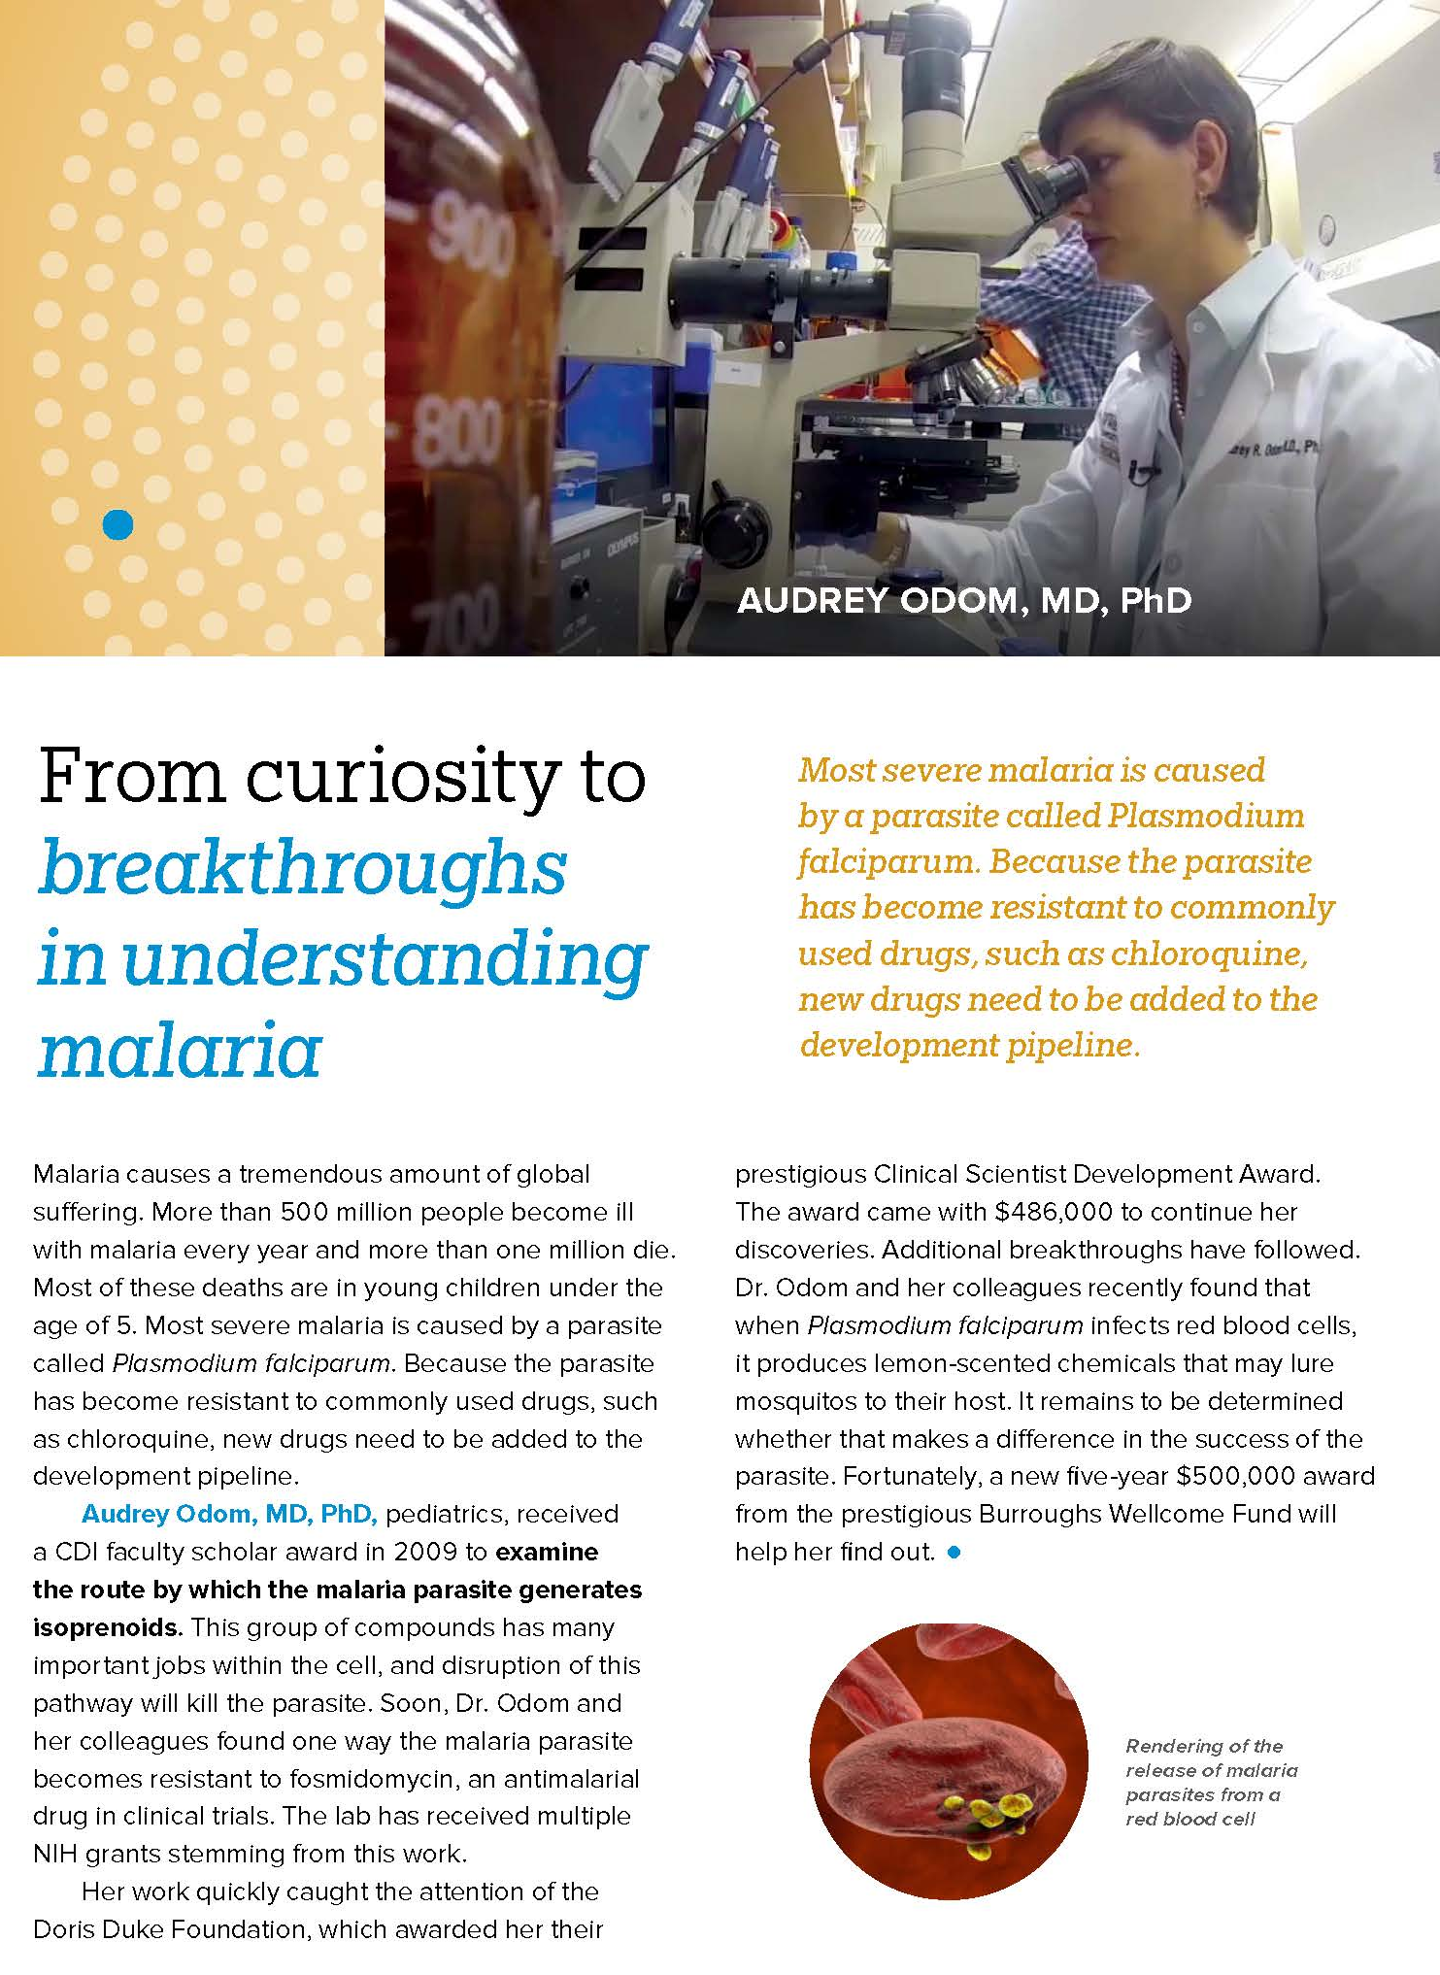
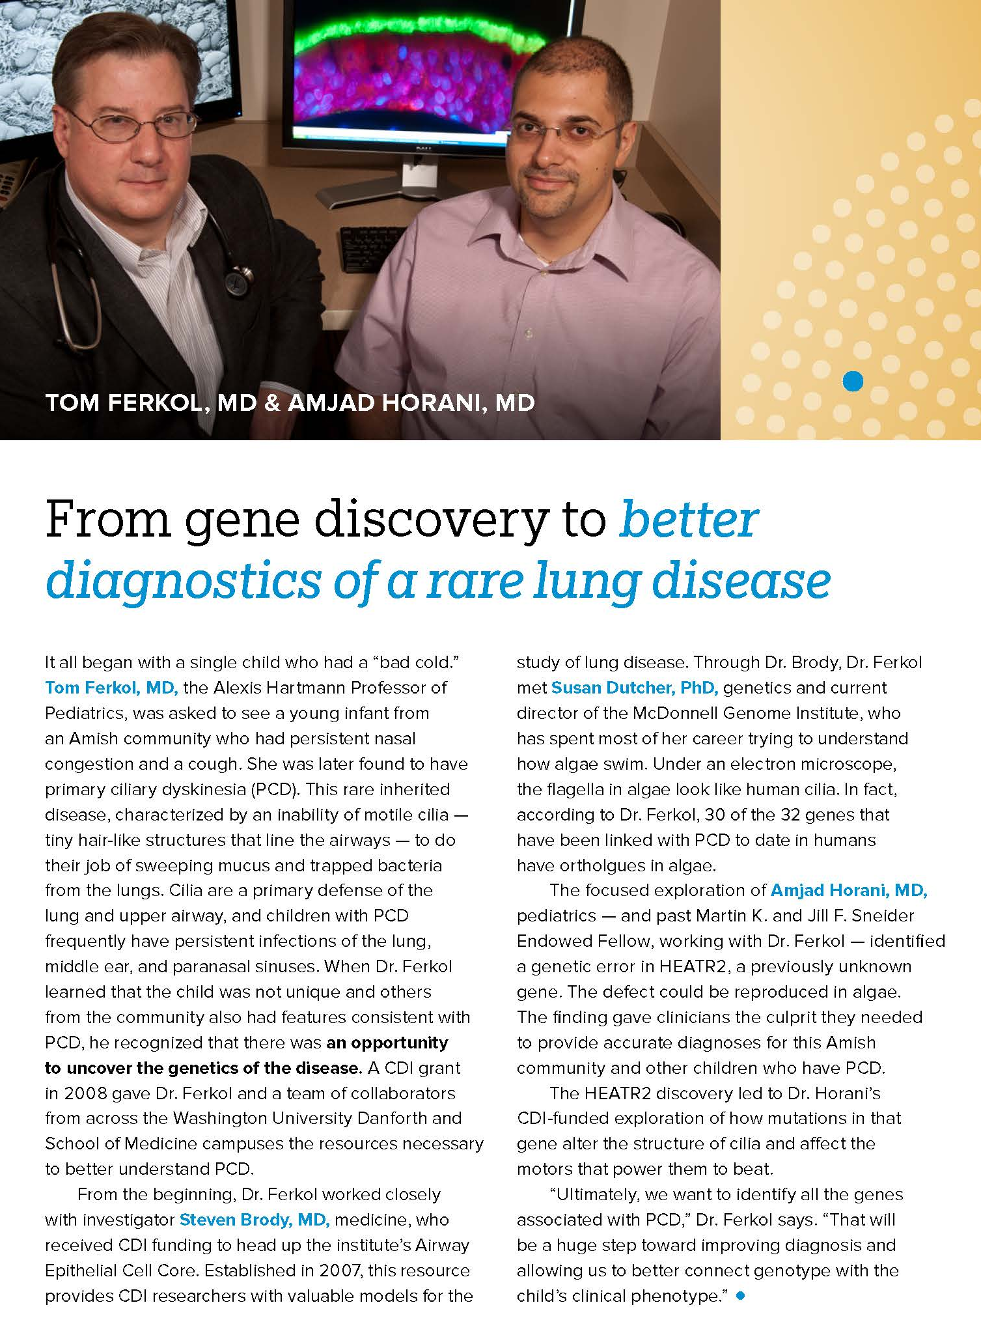
St. Louis Children’s Hospital

Slide 121
Annual Reports _ Greater Than $10,000
2nd Place
“Value Report”
MU Health Care
Columbia

Slide 122
Annual Reports _ Greater Than $10,000
3rd Place
“2016 Annual Report”
Saint Francis Healthcare System
Cape Girardeau

Slide 123
2017

Slide 124
External Publications/Routine _ Electronic
1st Place
“Club W Chat e-newsletter”
North Kansas City Hospital

Slide 125
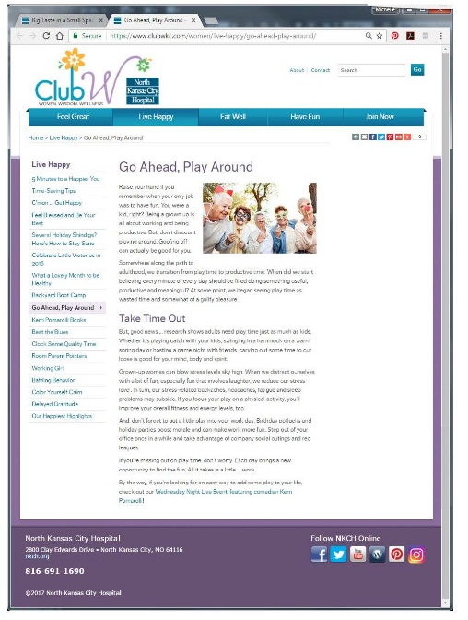
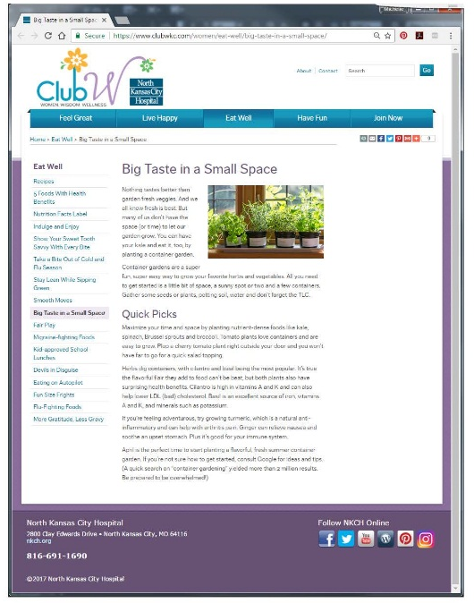
North Kansas City Hospital

Slide 126
External Publications/Routine _ Electronic
2nd Place
“Live Healthe”
MU Health Care
Columbia

Slide 127
External Publications/Routine _ Electronic
3rd Place
“The Link”
Children’s Mercy Kansas City

Slide 128
2017

Slide 129
External Publications/Routine _ Printed _ $10,000 or Less
1st Place
“MU Medicine Magazine”
MU Health Care
Columbia

Slide 130
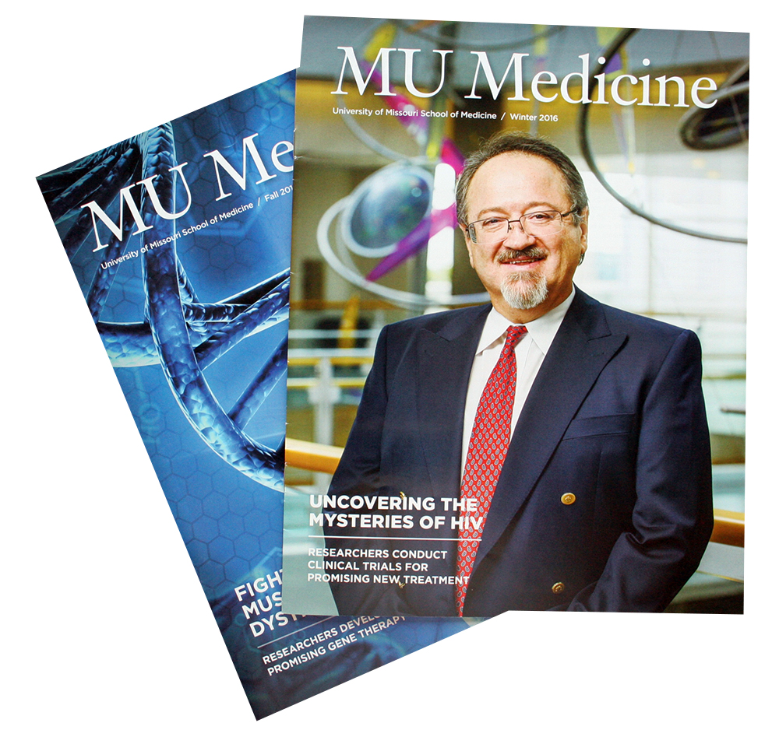
MU Health Care
Columbia

Slide 131
External Publications/Routine _ Printed _ $10,000 or Less
2nd Place
“The Pulse – Quarterly Newsletter”
Carroll County Memorial Hospital
Carrollton

Slide 132
2017

Slide 133
External Publications/Routine _ Printed _ Greater Than $10,000
1st Place
“MU Health Magazine”
MU Health Care
Columbia

Slide 134
MU Health Care
Columbia

Slide 135
External Publications/Routine _ Printed _ Greater Than $10,000
2nd Place
“Healthier Look Magazine”
SoutheastHEALTH
Cape Girardeau

Slide 136
External Publications/Routine _ Printed _ Greater Than $10,000
3rd Place
“Connections”
Liberty Hospital

Slide 137
2017

Slide 138
Internal Publications/Routine _ Electronic
1st Place
“InforMed Employee Newsletter”
SoutheastHEALTH
Cape Girardeau

Slide 139
SoutheastHEALTH
Cape Girardeau

Slide 140
Internal Publications/Routine _ Electronic
2nd Place
“MU Health Today”
MU Health Care
Columbia

Slide 141
Internal Publications/Routine _ Electronic
2nd Place
“CCMH Communication Boards”
Carroll County Memorial Hospital
Carrollton

Slide 142
2017

Slide 143
Internal Publications/Routine _ Printed _ $1,000 or Less
1st Place
“Vitals Employee Newsletter”
North Kansas City Hospital

Slide 144
North Kansas City Hospital

Slide 145
Internal Publications/Routine _ Printed _ $1,000 or Less
2nd Place
“The Faxx – Fitzgibbon Hospital Employee Newsletter”
Fitzgibbon Hospital
Marshall

Slide 146
Internal Publications/Routine _ Printed _ $1,000 or Less
3rd Place
“MU Health Weekly”
MU Health Care
Columbia

Slide 147
2017

Slide 148
Internal Publications/Routine _ Printed _ Greater Than $1,000
1st Place
“BJC TODAY”
BJC HealthCare
St. Louis

Slide 149
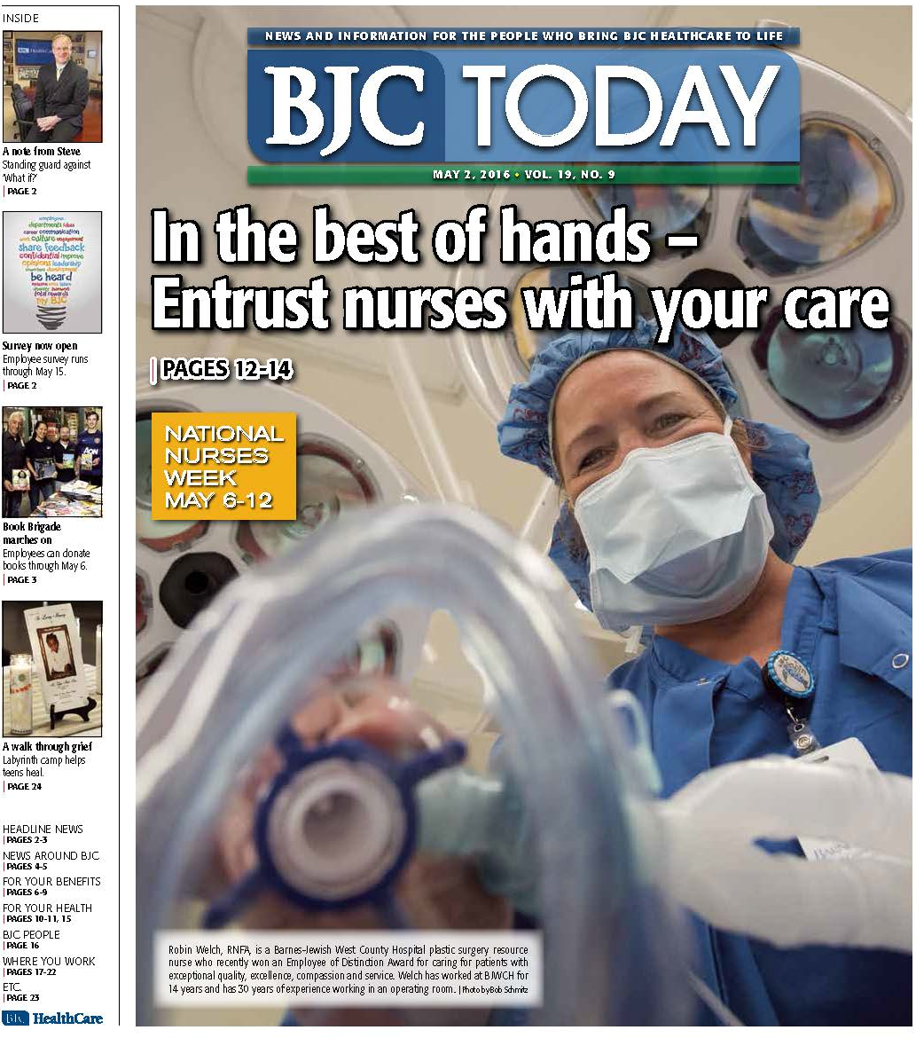
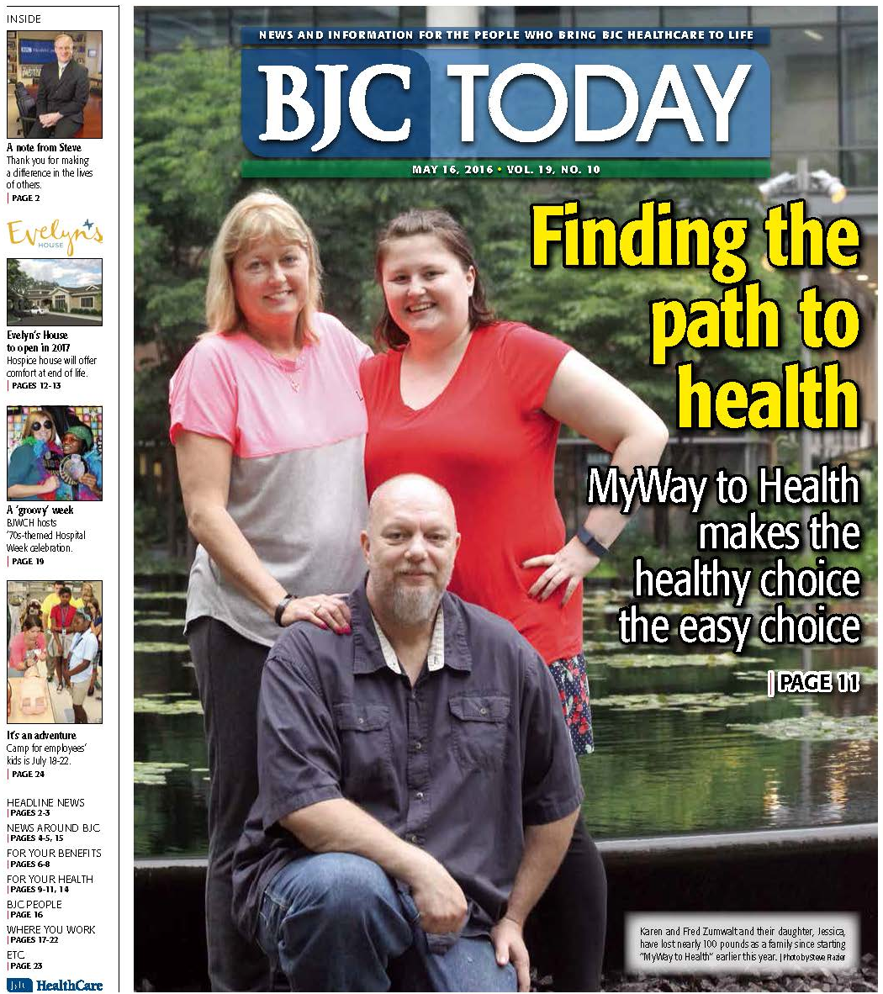
BJC HealthCare
St. Louis

Slide 150
Internal Publications/Routine _ Printed _ Greater Than $1,000
2nd Place
“Archives Magazine”
MU Health Care
Columbia

Slide 151
Internal Publications/Routine _ Printed _ Greater Than $1,000
3rd Place
“CoxHealth Connection”
CoxHealth
Springfield

Slide 152
2017

Slide 153
Media Relations Activity or Program _ Mid to Large Size Hospital
1st Place
“Saint Luke’s Hospital NICU
Super Babies”
Saint Luke’s Health System
Kansas City

Slide 154
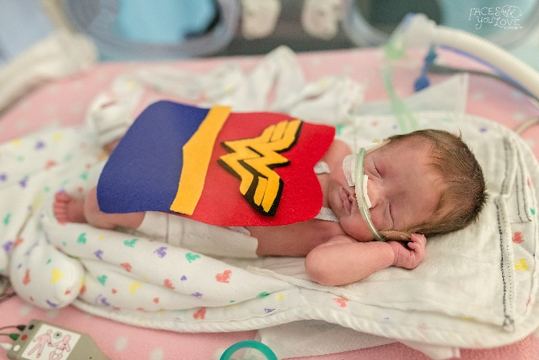
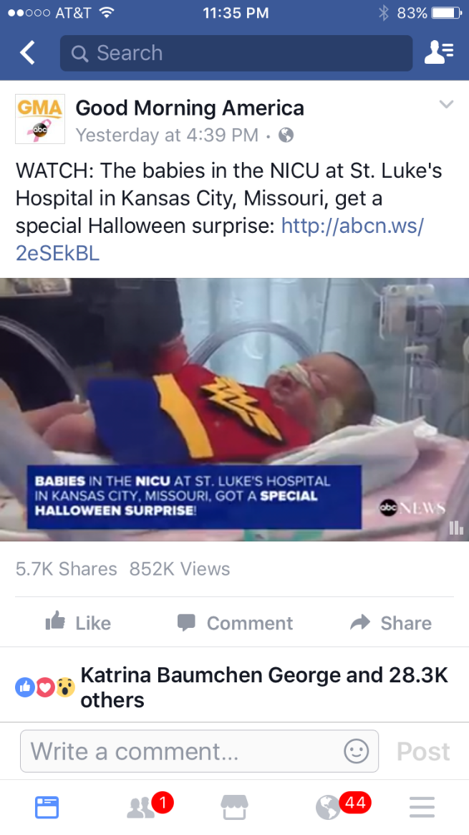
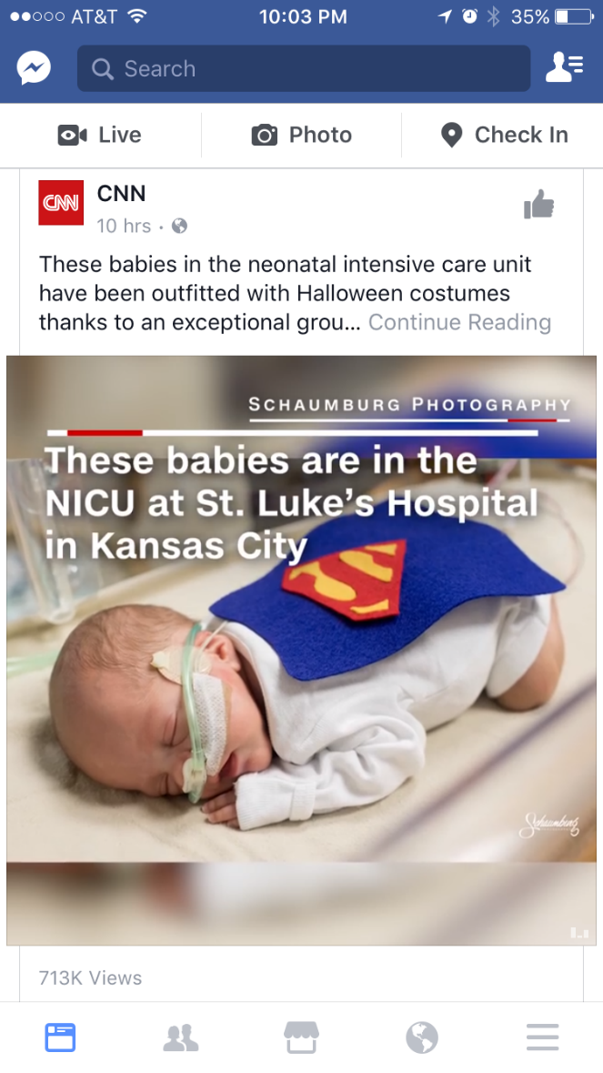
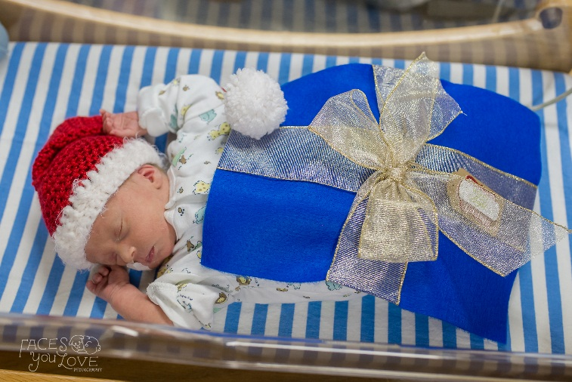
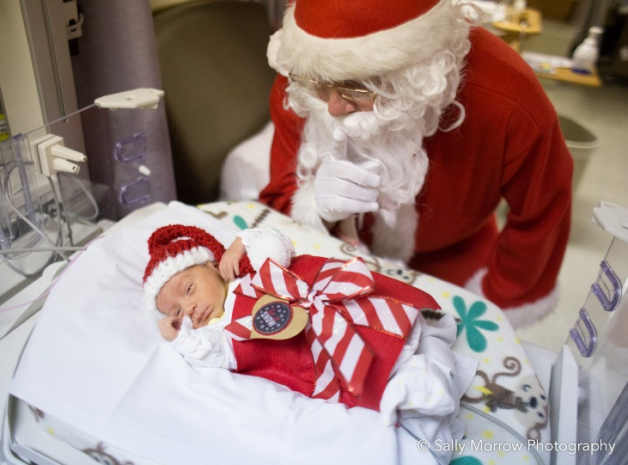
Saint Luke’s Health System
Kansas City

Slide 155
Saint Luke’s Health System
Kansas City

Slide 156
Media Relations Activity or Program _ Mid to Large Size Hospital
2nd Place
“Allergy toothpaste”
MU Health Care
Columbia

Slide 157
Media Relations Activity or Program _ Mid to Large Size Hospital
3rd Place
“Mammography van”
MU Health Care
Columbia

Slide 158
2017

Slide 159
Photography
1st Place
“Window Washers”
MU Health Care
Columbia

Slide 160
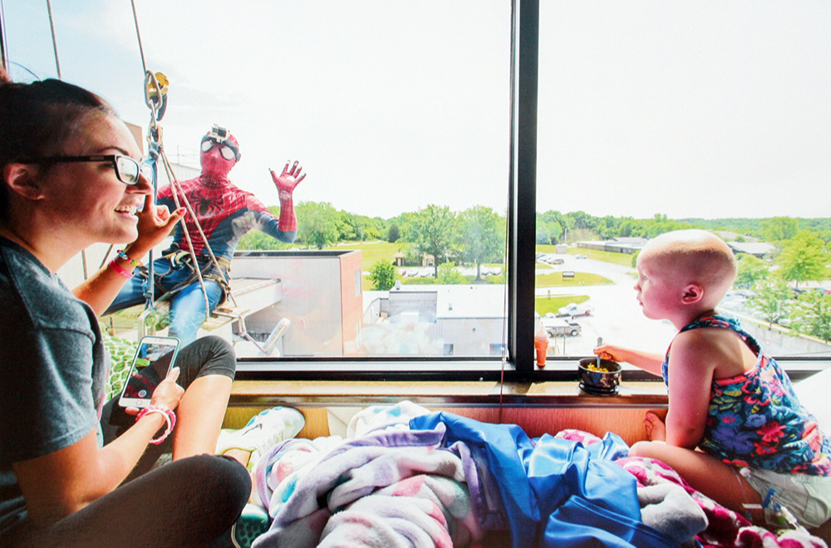
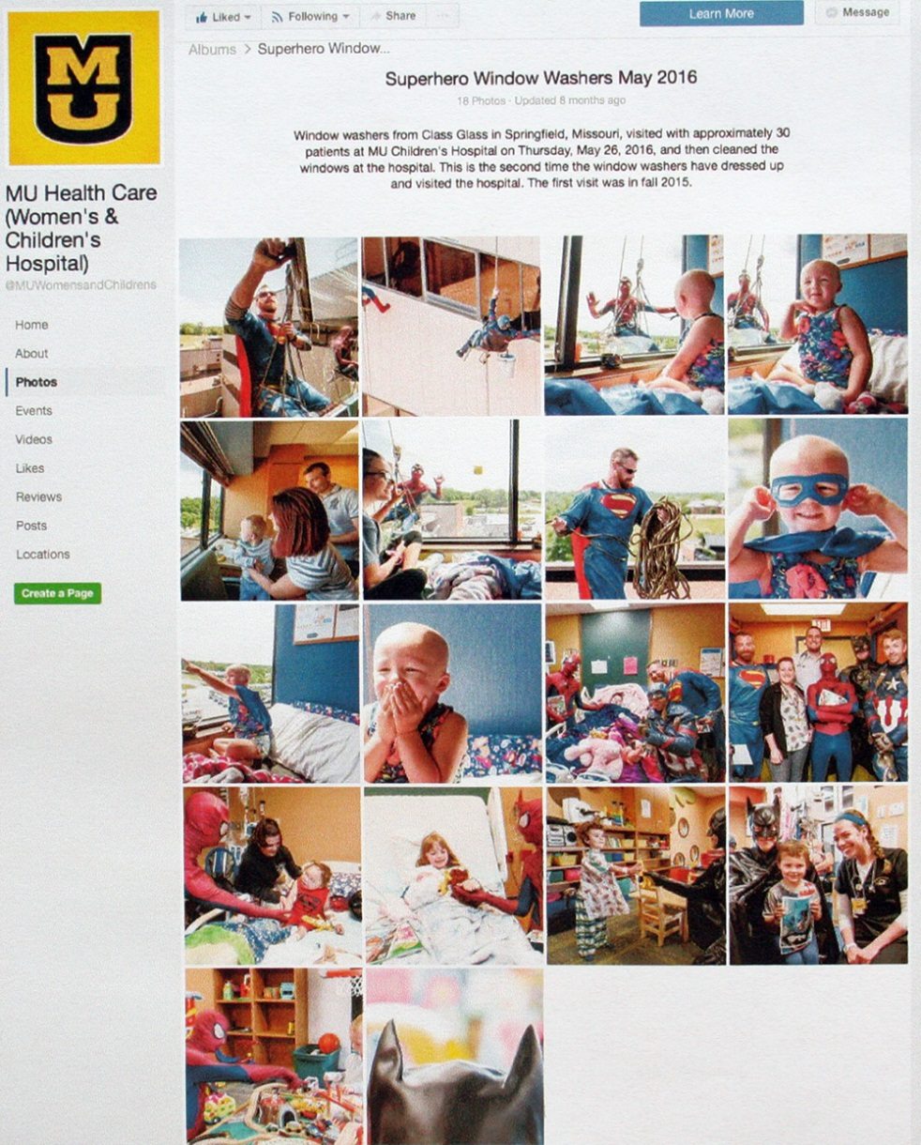
MU Health Care
Columbia

Slide 161
Photography
1st Place
“Ruby Hayes…102 and Counting”
SoutheastHEALTH
Cape Girardeau

Slide 162
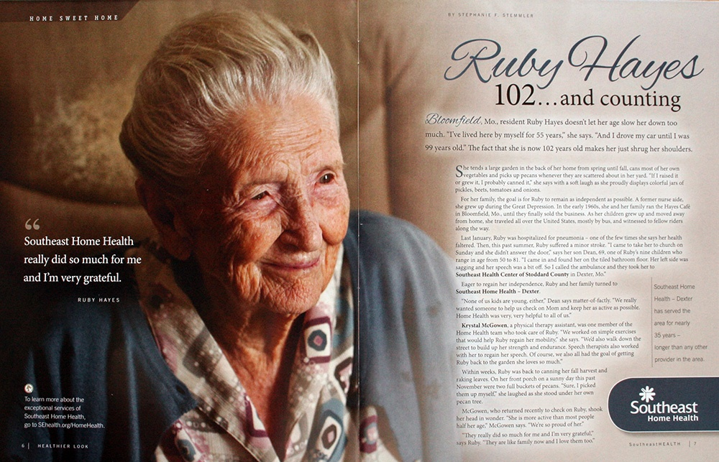
SoutheastHEALTH
Cape Girardeau

Slide 163
2017

Slide 164
Special Purpose Publications _ $5,000 or Less
1st Place
“Children’s Mercy Endowed Fund Stewardship Report”
Children’s Mercy Kansas City

Slide 165
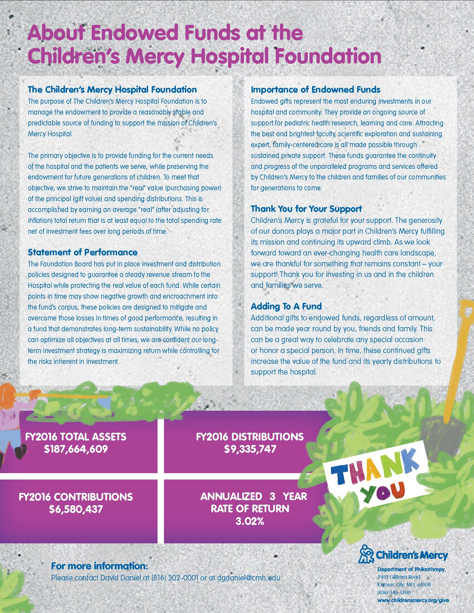
Children’s Mercy Kansas City

Slide 166
Special Purpose Publications _ $5,000 or Less
2nd Place
“Hey Girl! Keep Calm Brochure”
Ozarks Medical Center
West Plains

Slide 167
Special Purpose Publications _ $5,000 or Less
3rd Place
“2016 Infographics Card”
Children’s Mercy Kansas City

Slide 168
2017

Slide 169
Special Purpose Publications _ Greater Than $5,000
1st Place
“2017 Photo Calendar”
SoutheastHEALTH
Cape Girardeau

Slide 170
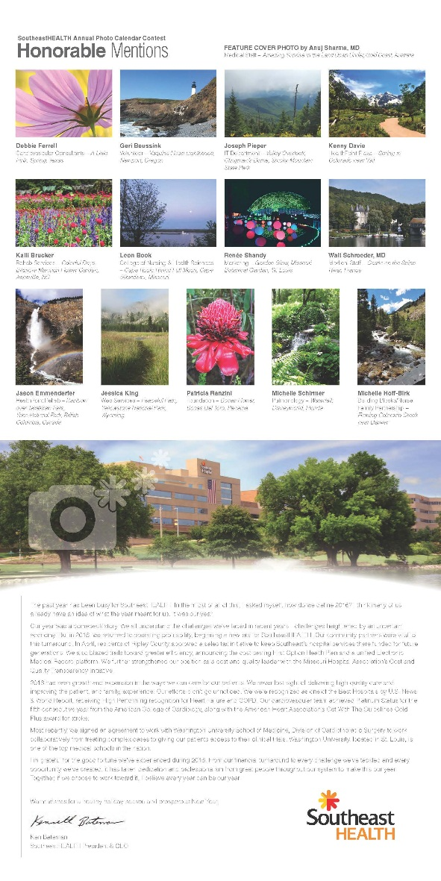
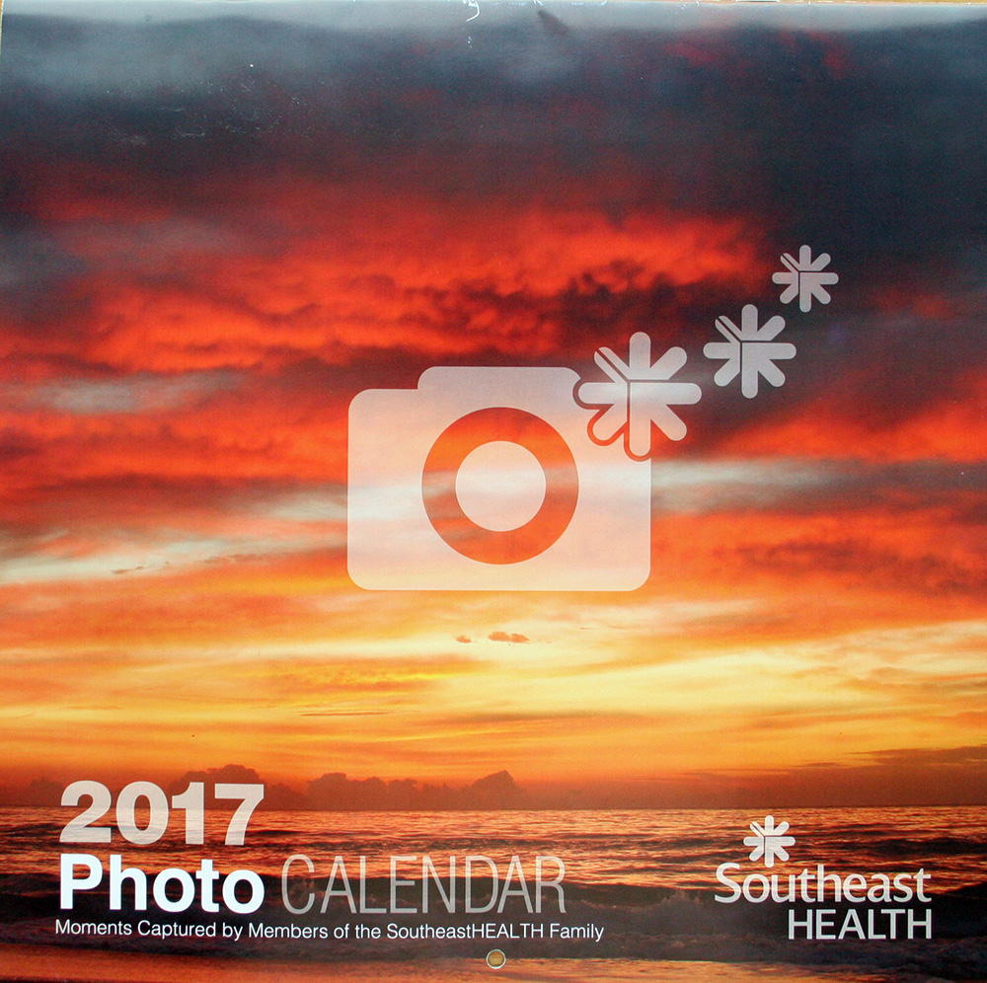
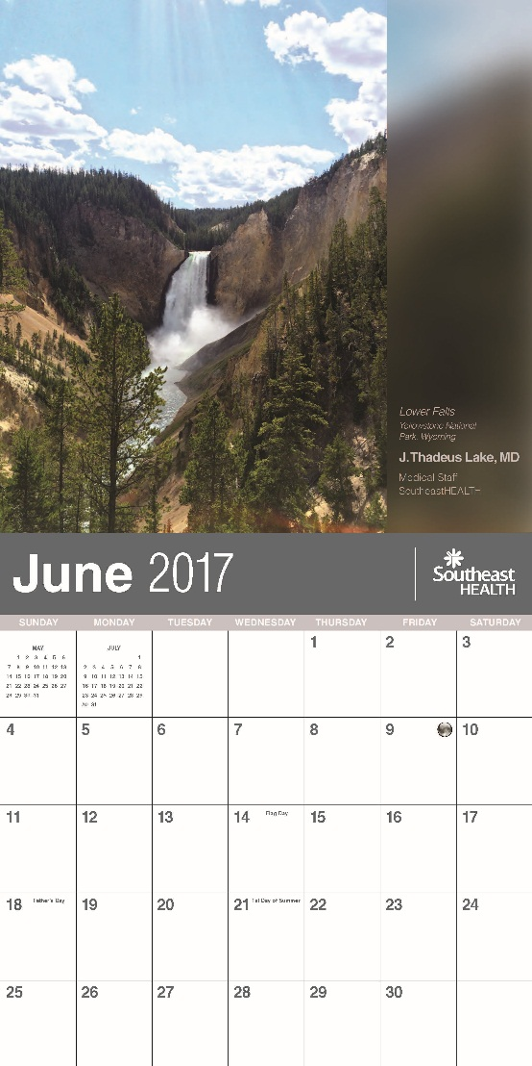
SoutheastHEALTH
Cape Girardeau

Slide 171
Special Purpose Publications _ Greater Than $5,000
2nd Place
“Pink Up 2016 Campaign”
Saint Francis Healthcare System
Cape Girardeau

Slide 172
Special Purpose Publications _ Greater Than $5,000
3rd Place
“Trauma Referral Guide”
MU Health Care
Columbia

Slide 173
2017

Slide 174
Video _ $5,000 or Less
1st Place
“A Kidney Transplant Love Story”
Saint Luke’s Health System
Kansas City

Slide 175
Saint Luke’s Health System
Kansas City

Slide 176
Video _ $5,000 or Less
2nd Place
“Tips for Preventing Falls”
MU Health Care
Columbia

Slide 177
Video _ $5,000 or Less
3rd Place
“North Kansas City Hospital
Admissions Video”
North Kansas City Hospital

Slide 178
2017

Slide 179
Video _ Greater Than $5,000
1st Place
“Year in Review”
SoutheastHEALTH
Cape Girardeau

Slide 180
SoutheastHEALTH
Cape Girardeau

Slide 181
Video _ Greater Than $5,000
2nd Place
“Fall 2016 Saint Luke’s
Employee Town Hall Video”
Saint Luke’s Health System
Kansas City

Slide 182
Video _ Greater Than $5,000
3rd Place
“Kids Safety Video”
CoxHealth
Springfield

Slide 183
2017

Slide 184
Writing _ Written for Employee/Physician Audience
1st Place
“Party Patrol provides
special memories”
BJC HealthCare
St. Louis

Slide 185
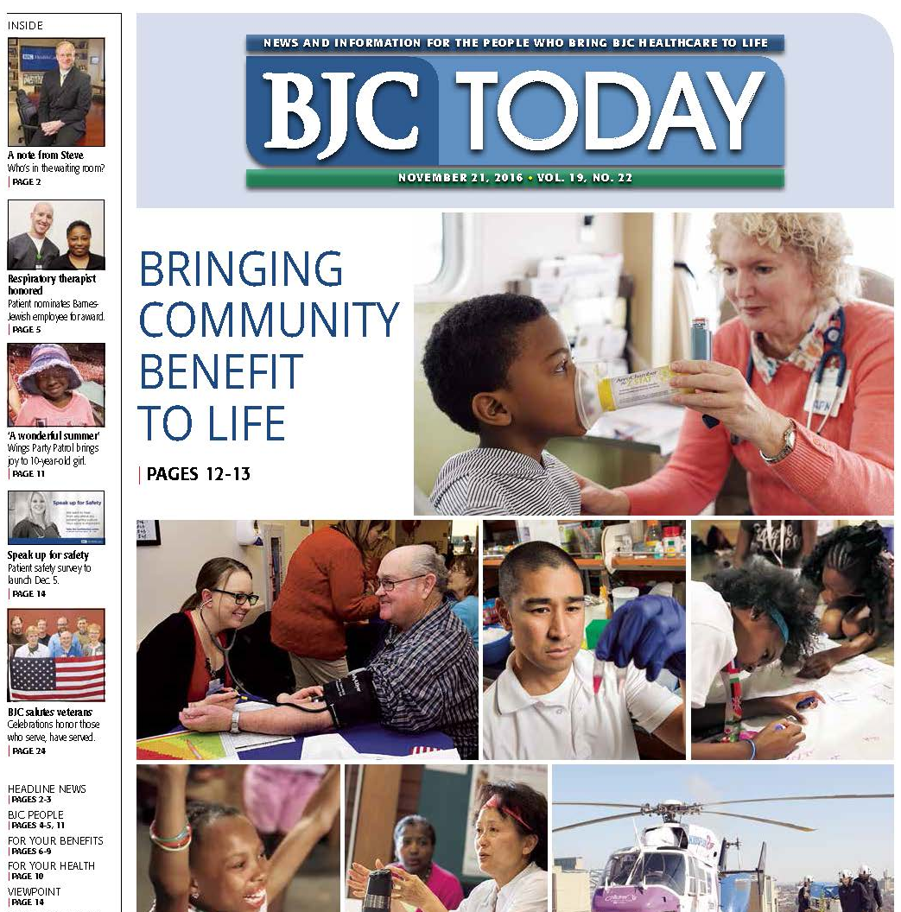
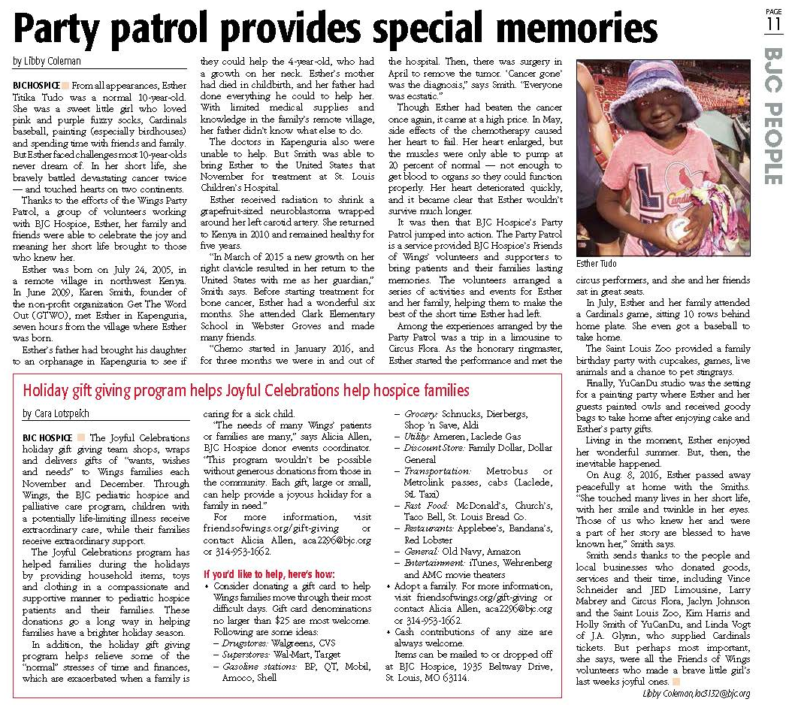
BJC HealthCare
St. Louis

Slide 186
Writing _ Written for Employee/Physician Audience
2nd Place
“A Memorial Day salute to
military veterans”
BJC HealthCare
St. Louis

Slide 187
Writing _ Written for Employee/Physician Audience
3rd Place
“Man of many talents”
MU Health Care
Columbia

Slide 188
2017

Slide 189
Writing _ Written for All Other Audiences
1st Place
“Game Changer”
SoutheastHEALTH
Cape Girardeau

Slide 190
SoutheastHEALTH
Cape Girardeau

Slide 191
Writing _ Written for All Other Audiences
2nd Place
“Pickett Retires Uneven Shoes After Life-Changing Surgery”
Fitzgibbon Hospital
Marshall

Slide 192
Writing _ Written for All Other Audiences
3rd Place
“Calling All Campers”
SoutheastHEALTH
Cape Girardeau

Slide 193
2017

Slide 194
Best of Show
“Guardians of Childhood”
St. Louis Children’s Hospital

Slide 195
St. Louis Children’s Hospital

Slide 196
St. Louis Children’s Hospital

Slide 197
2017

